Slide 1
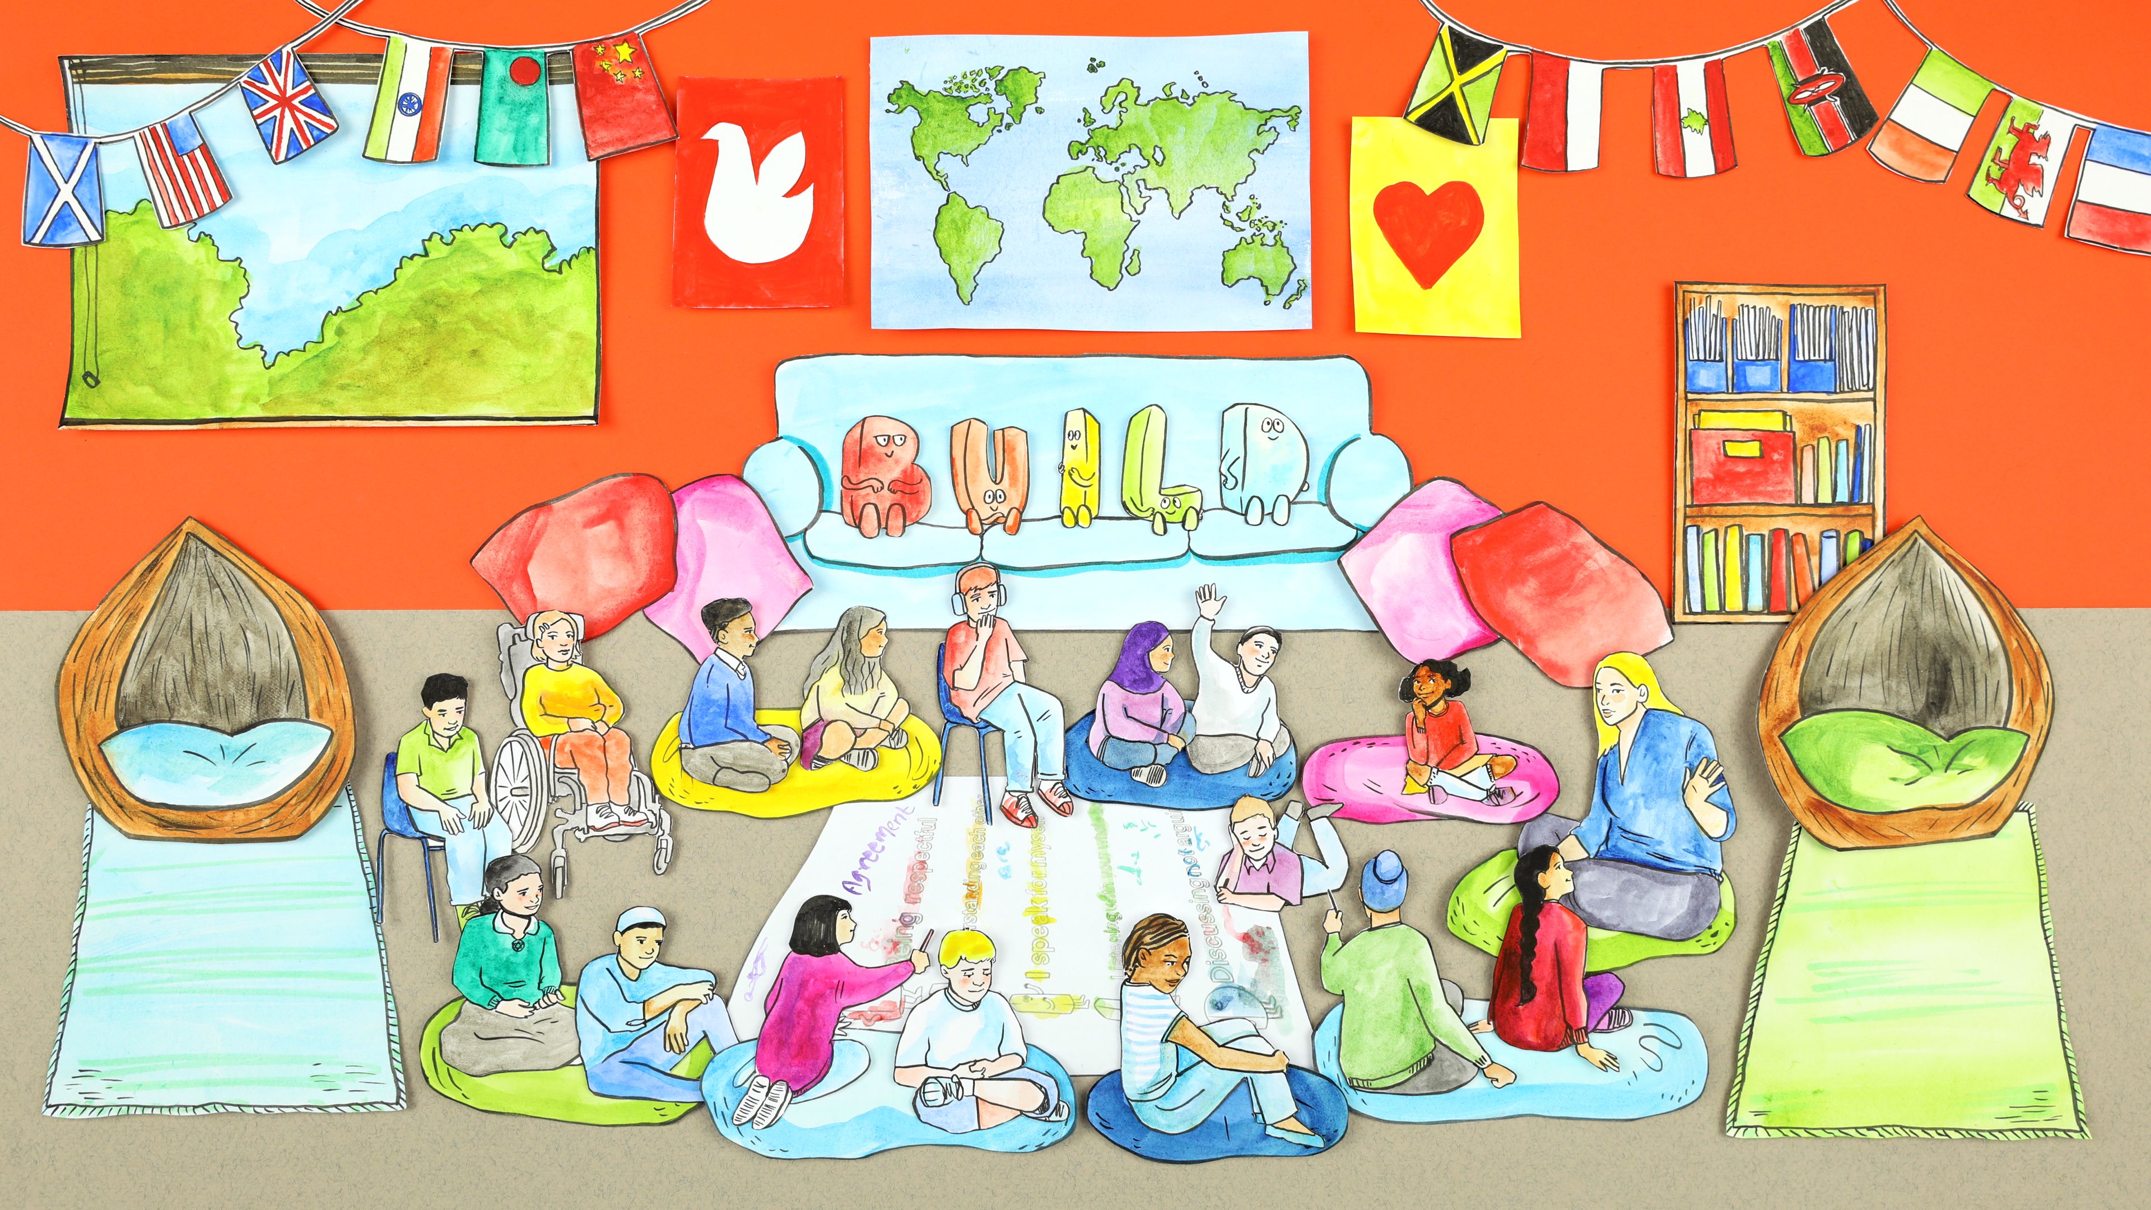

BUILDing a Safe Space

Slide 2
Today we will ...
Explore and understand why it is important to make everyone feel comfortable to talk about themselves
Create a class Safe Space agreement

Slide 3


Activity 1: Think, pair & share QUESTION: What makes you feel comfortable to share things about yourself with others?

Slide 4
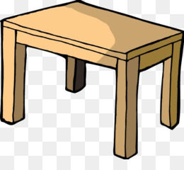
Activity 2: Table Topics!

Slide 5
What would you do if you had a million pounds?

Slide 6
Would you prefer to stay in a tent or a hotel?

Slide 7
If you could, would you change your name?

Slide 8
What food would you eat every day if you could?

Slide 9
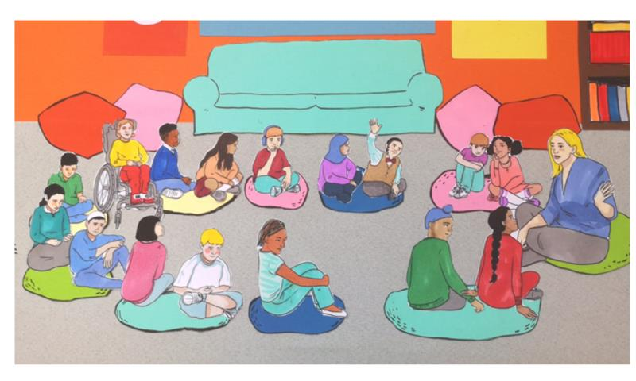
Did you learn something new about someone on your table?
Did you find anything in common with someone else?
Did something someone said surprised you?
Did you feel you got to know someone a little better today?

Slide 10
Talking to others and trying to get to know them is really important in learning that everyone is different and special We also often find we have things in common.

Slide 11

Activity 3: Watch the BUILD film
https://www.youtube.com/watch?v=VkVkooLbcXU

Slide 12
Were there any letters or ideas you really liked?

Slide 13
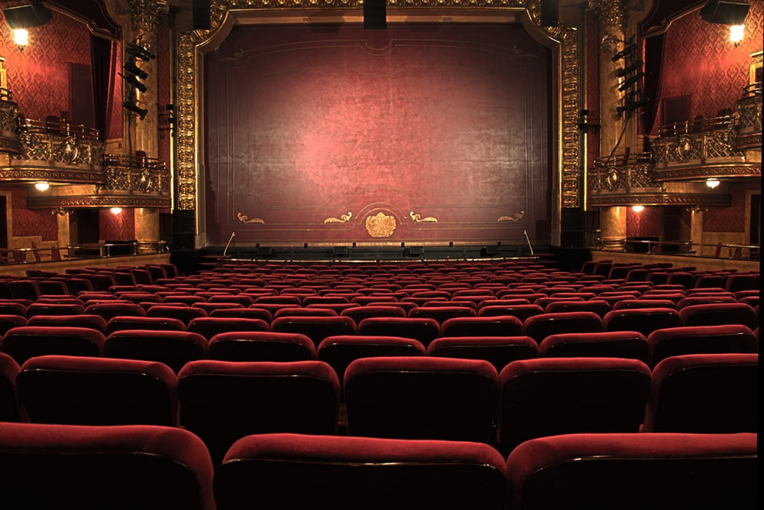
Activity 4: Charades!

Slide 14
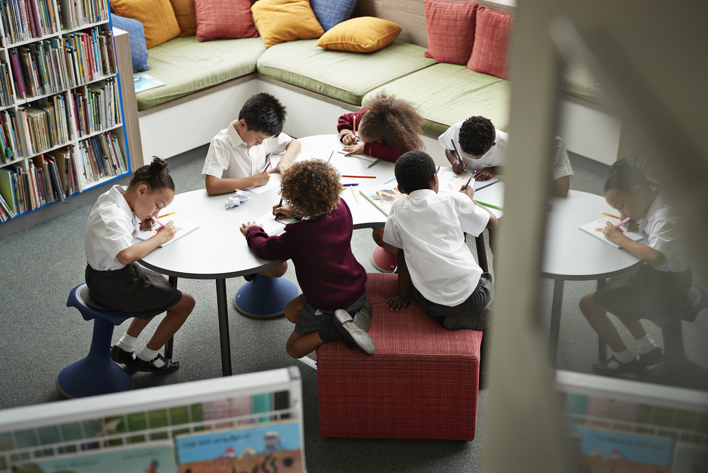
Activity 5: Posters, create your own agreement

Slide 15
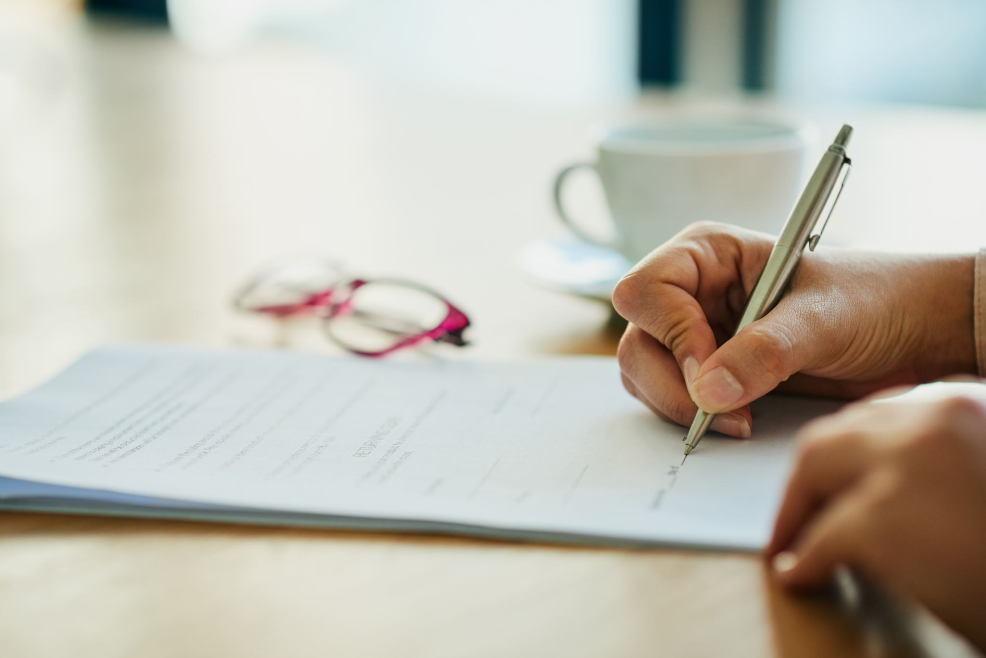
Activity 6: Sign the agreement

Slide 16

Next lesson
The next lesson is
The Letter B …
B is for Be Respectful

Slide 17
Extra questions!
1.What would a world without any rules be like? Could you draw a picture of this?
2. What could happen if we didn’t think about creating a safe space?
2.What BUILD idea you think is the most important?

