Slide 1
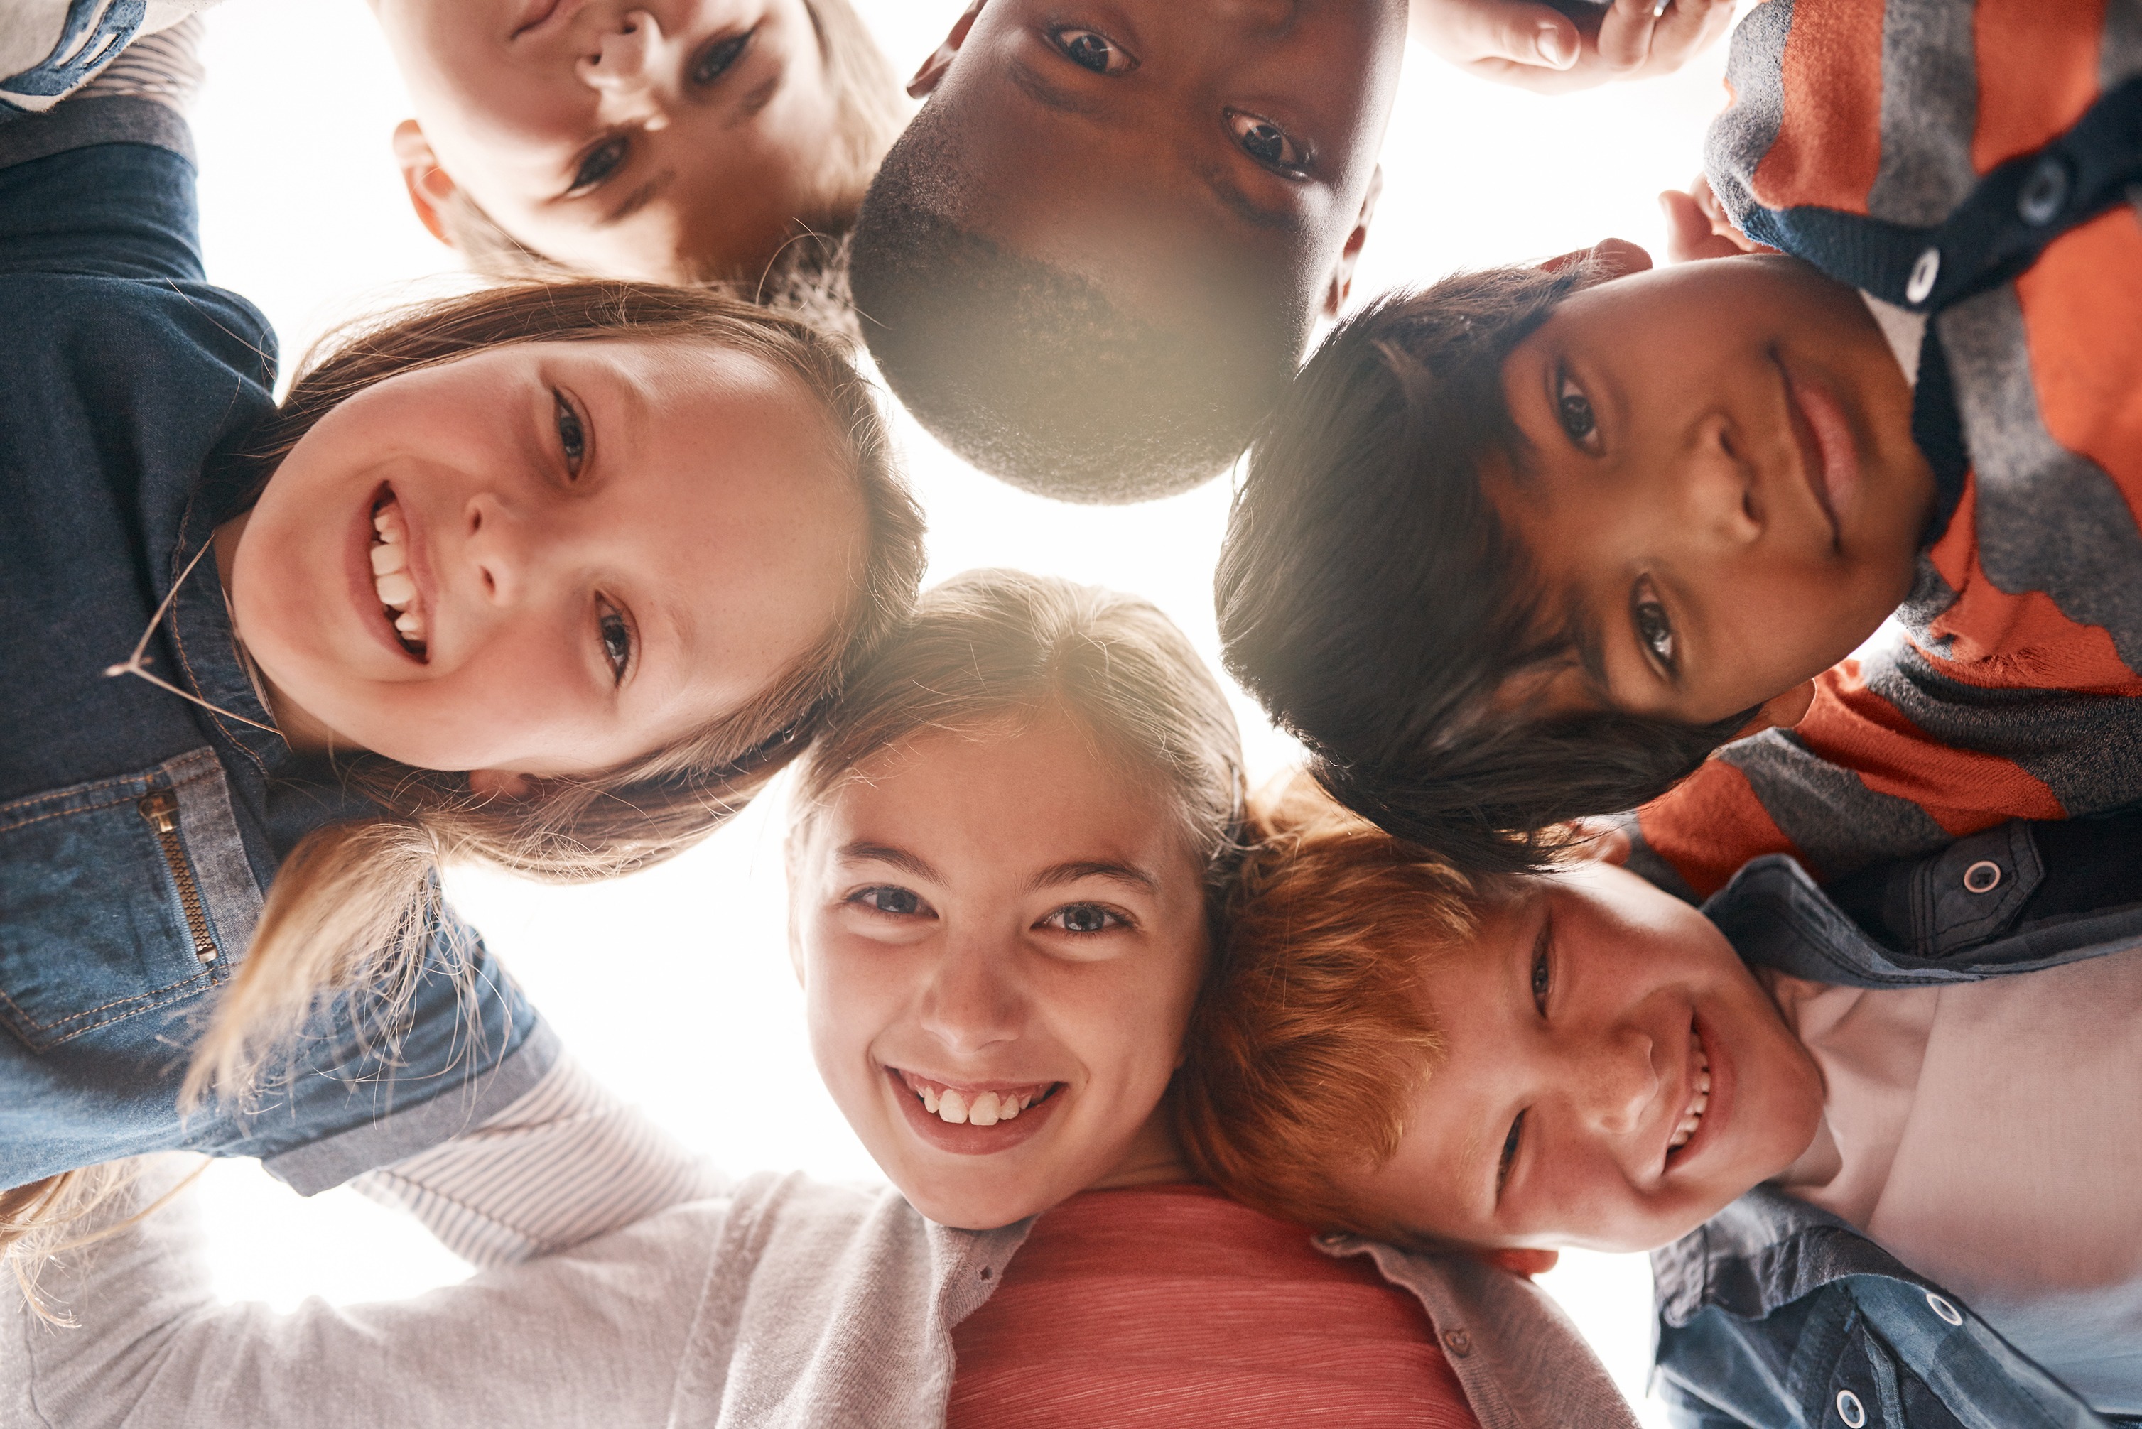

What is Identity?

Slide 2
Today we are going to talk about the word 'Identity'. What makes you YOU!

Slide 3
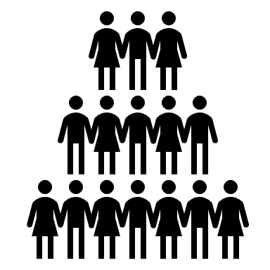
Activity 1
Stand together if...

Slide 4
Stand together if...
You walked to school today
You are the oldest in your family
You speak more than 1 language
You have a religion or belief
You have brown eyes
You don't like carrots
Your favourite colour is green

Slide 5

Thoughts...
What did it feel like when you were in the middle?
Why do you think I was asking you questions about your family, your hobbies, what you believe and what you like?
Your identity makes you special and unique. ‘Unique’ means that although some people’s identities might be similar to yours, nobody in the world has an identity exactly the same as you and that makes you very special – you are the only you in the world, and that’s something that you can feel proud about and celebrate

Slide 6
Teacher’s Identity Worksheet
Which places are important to me and my family?
Which people are important to me in my life?
What is my personality like?
What do I look like?
What beliefs and values are important to me?
What do I like doing?
Activity 2: Teachers Identity worksheet

Slide 7
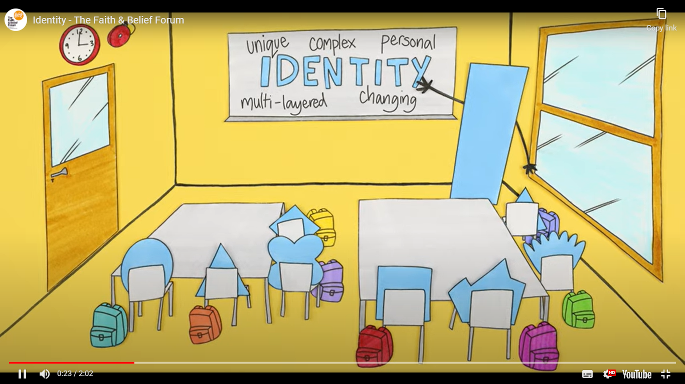
Identity Film
Let’s watch a short film…
PLAY FILM
Activity 3: Identity film

Slide 8
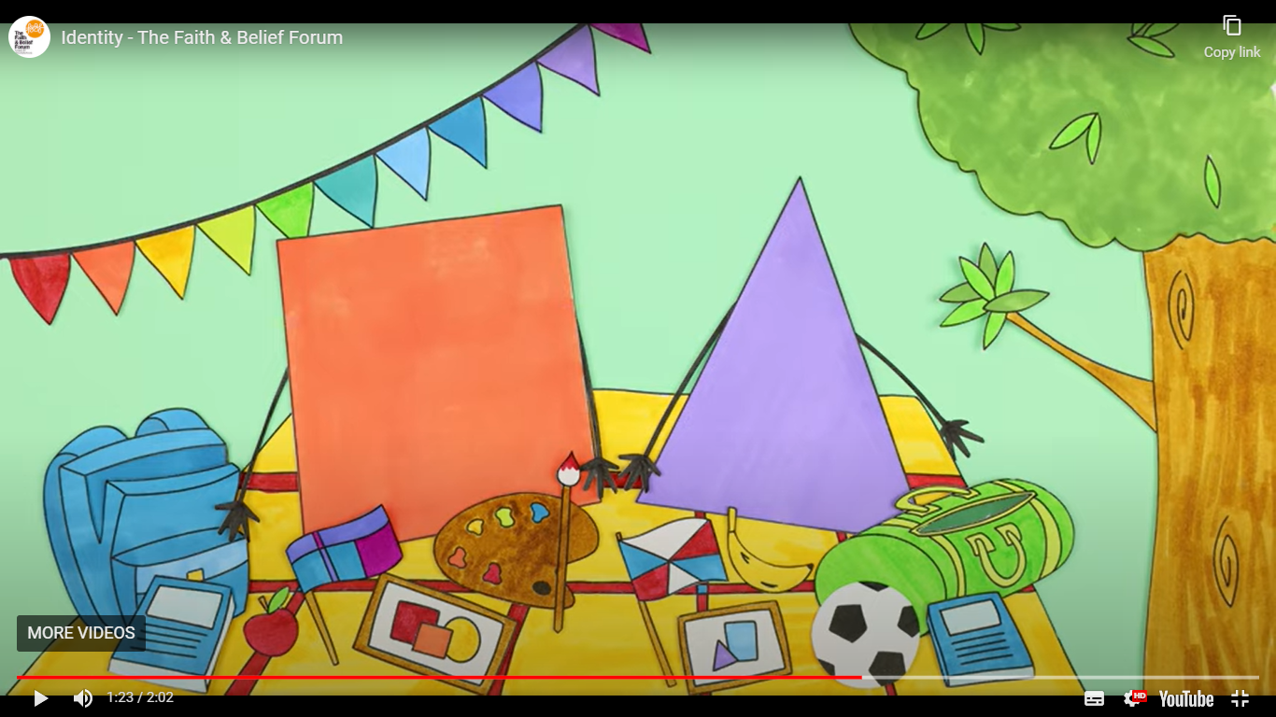
Questions and discussion
Questions:
What objects of the two students (shapes) identities can you see in the film?
If you met some of the students in the film for the first time, what questions could you ask to get to know them better?
Identity film discussion

Slide 9
My Identity Worksheet
Which places are important to me and my family?
Which people are important to me in my life?
What is my personality like?
What do I look like?
What beliefs and values are important to me?
What do I like doing?
Activity 4:
My activity worksheet

Slide 10
Identity thoughts
Our identity is what makes us who we are
All the things that make us ‘us’
Everybody’s identity is unique. There are no two people in the world with the same identity – not even twins!
Some parts of our identity might be the same as other people’s
Our similarities and difference are things to be celebrated

Slide 11
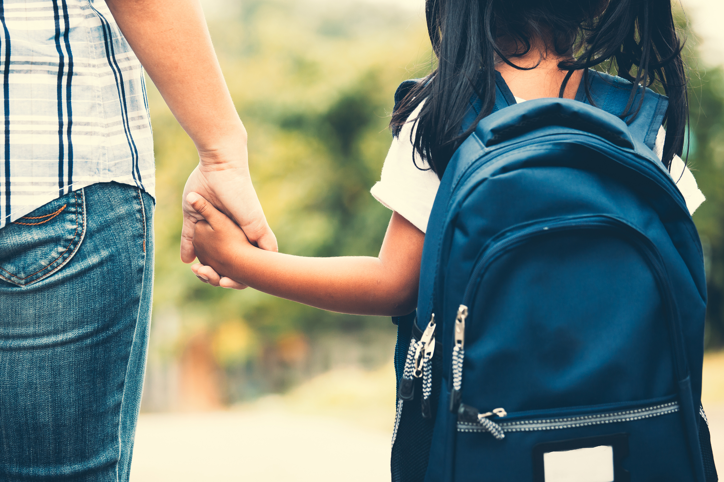
Next lesson..
Next lesson we are going make our own backpack and explore the things about us that can be seen, but also the things about us that can’t be seen.

