Slide 1

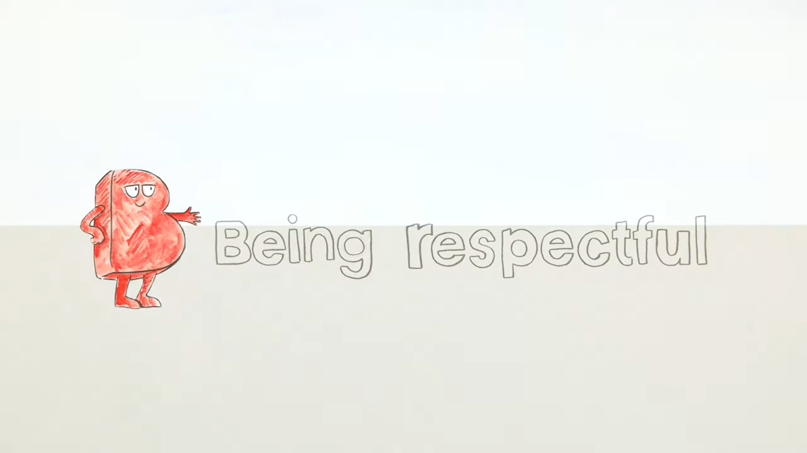

B is for Being Respectful

Slide 2
Recap of last lesson…
In the last lesson:
we created a safe space agreement
we discussed why it is important to do this, so we all feel comfortable to share our experiences and views
we watched the BUILD film

Slide 3
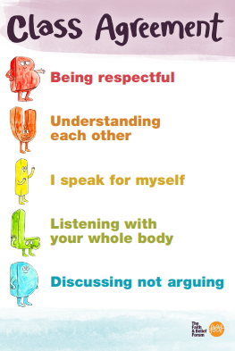
Recap your class agreement

Slide 4
Today we are going to…
To explore the principle of Respect
To understand why it’s important we respect each other
To learn about respectful behaviors and disrespectful behaviors

Slide 5

What does the word RESPECT mean?
Think or write your answers

Slide 6
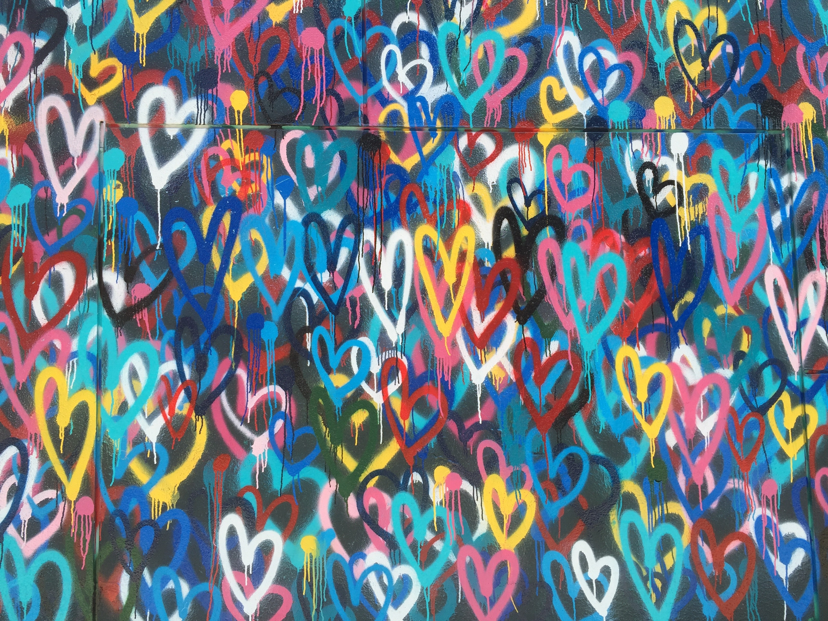
Activity 1
The meaning of respect
Take a walk around and pick a meaning!

Slide 7
Respect means:
Being kind and helpful to others
Telling the truth – being honest
Giving other people space
Being kind to yourself
Being polite, especially to teachers and carers
What else?

Slide 8
Activity 2: images

Slide 9
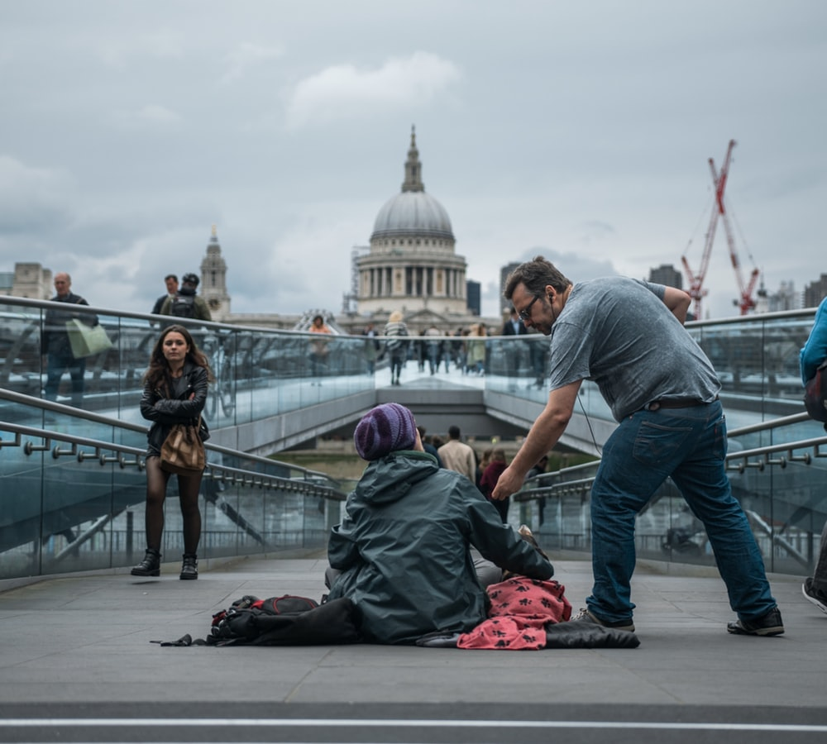
Look at the images and tell us what you see

Slide 10
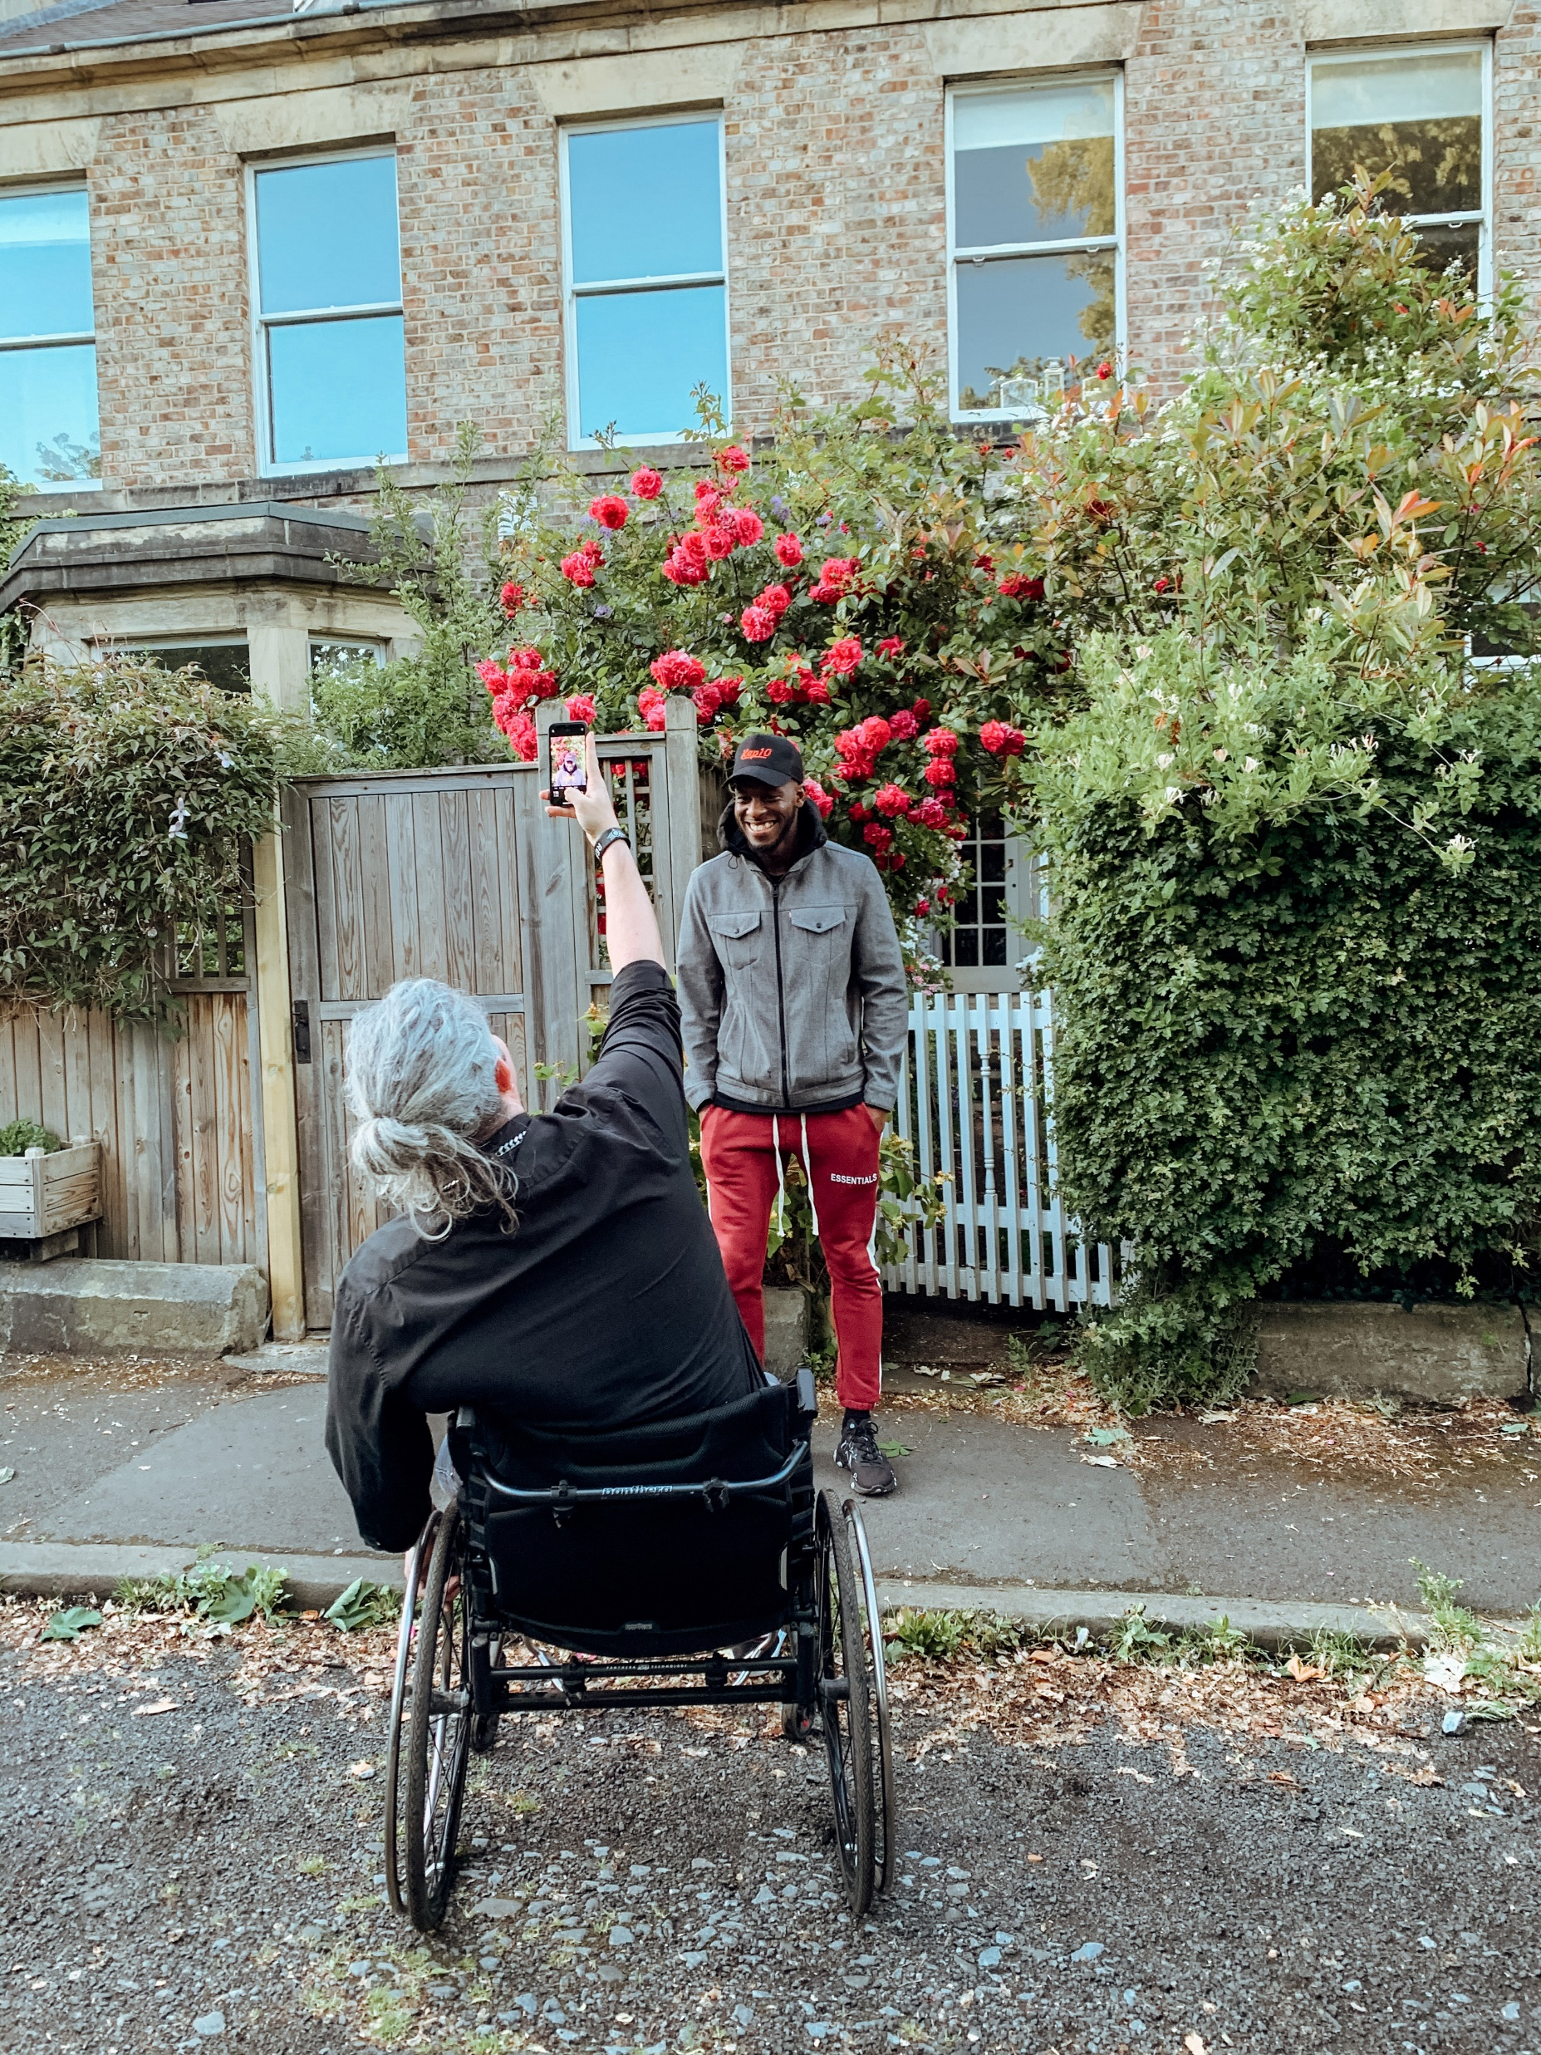
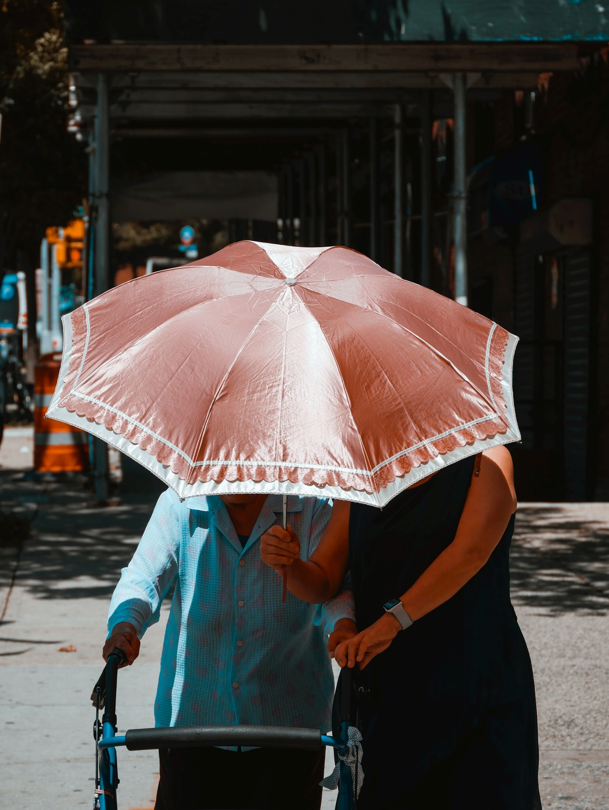
Look at the images and tell us what you see

Slide 11
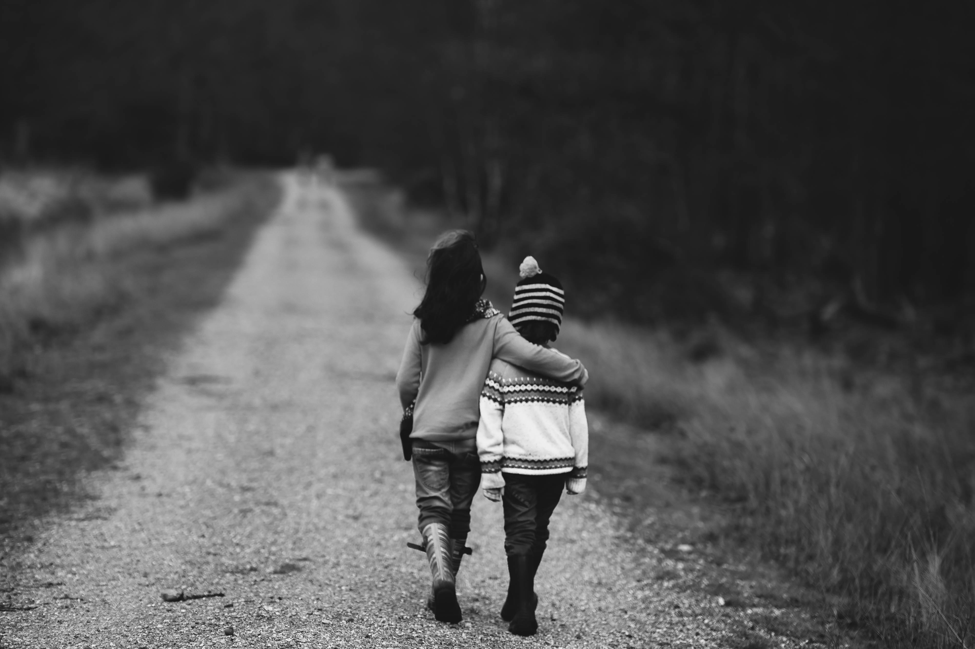

Slide 12
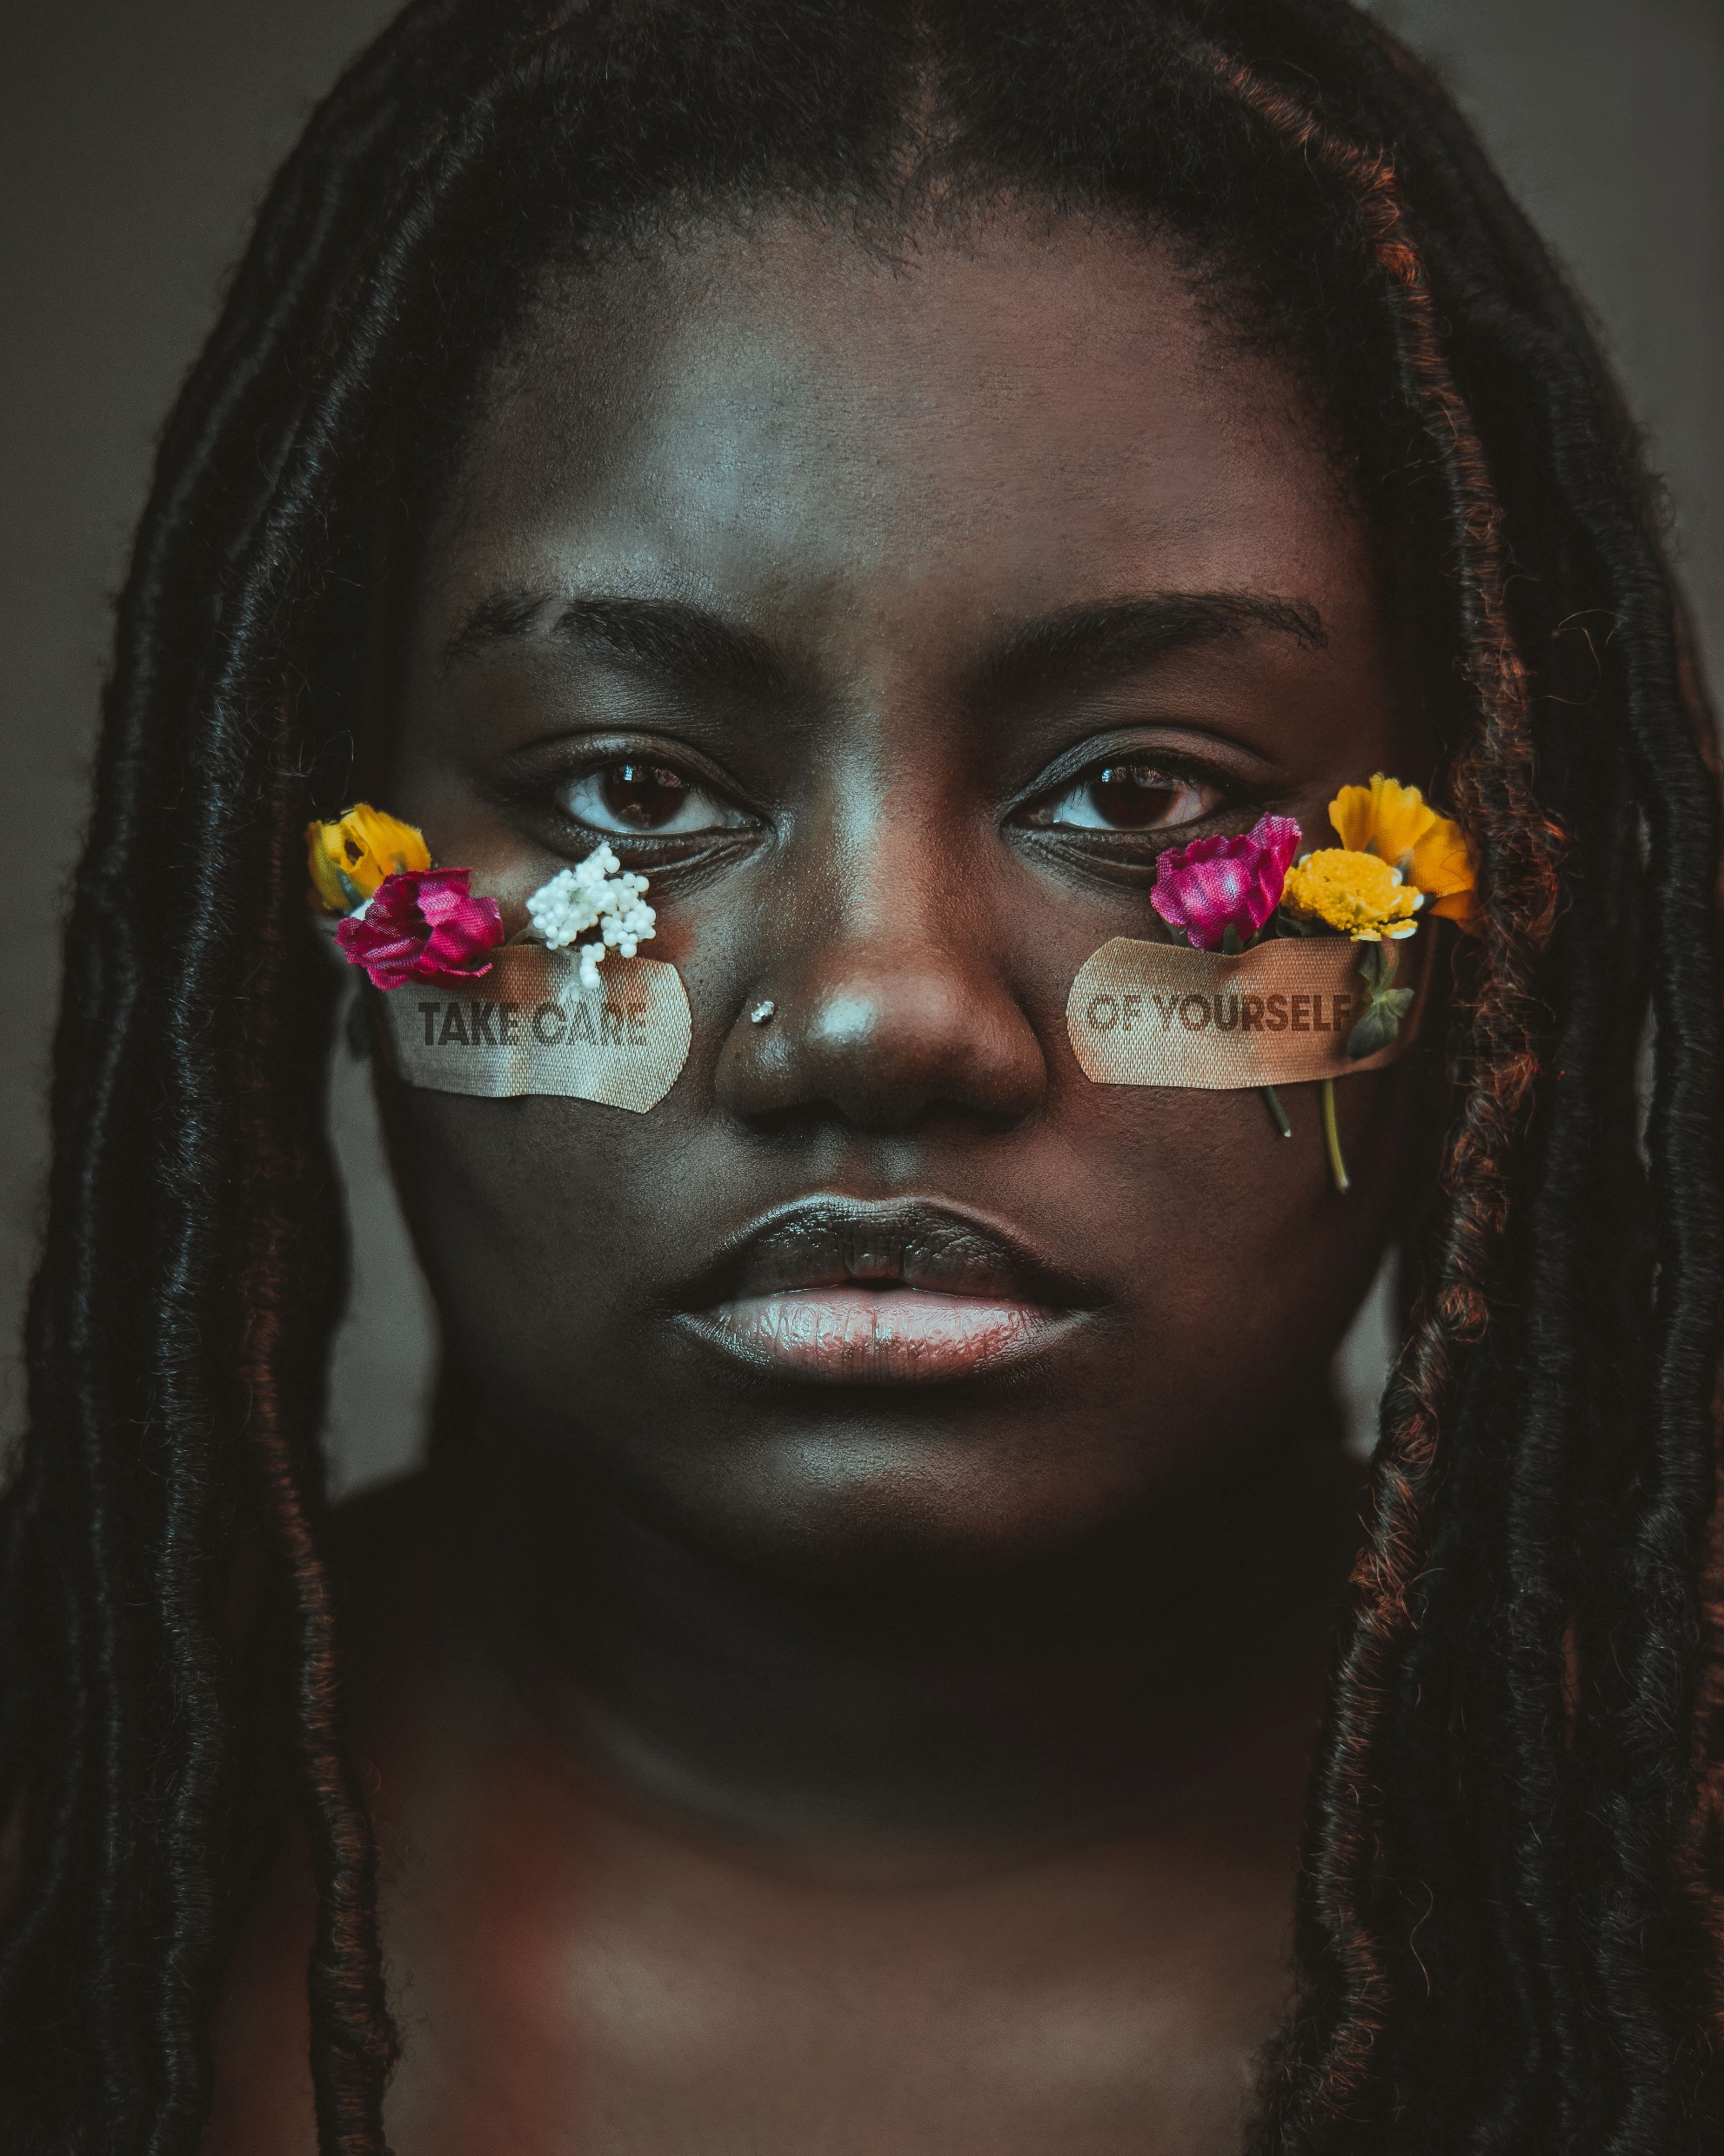

Slide 13
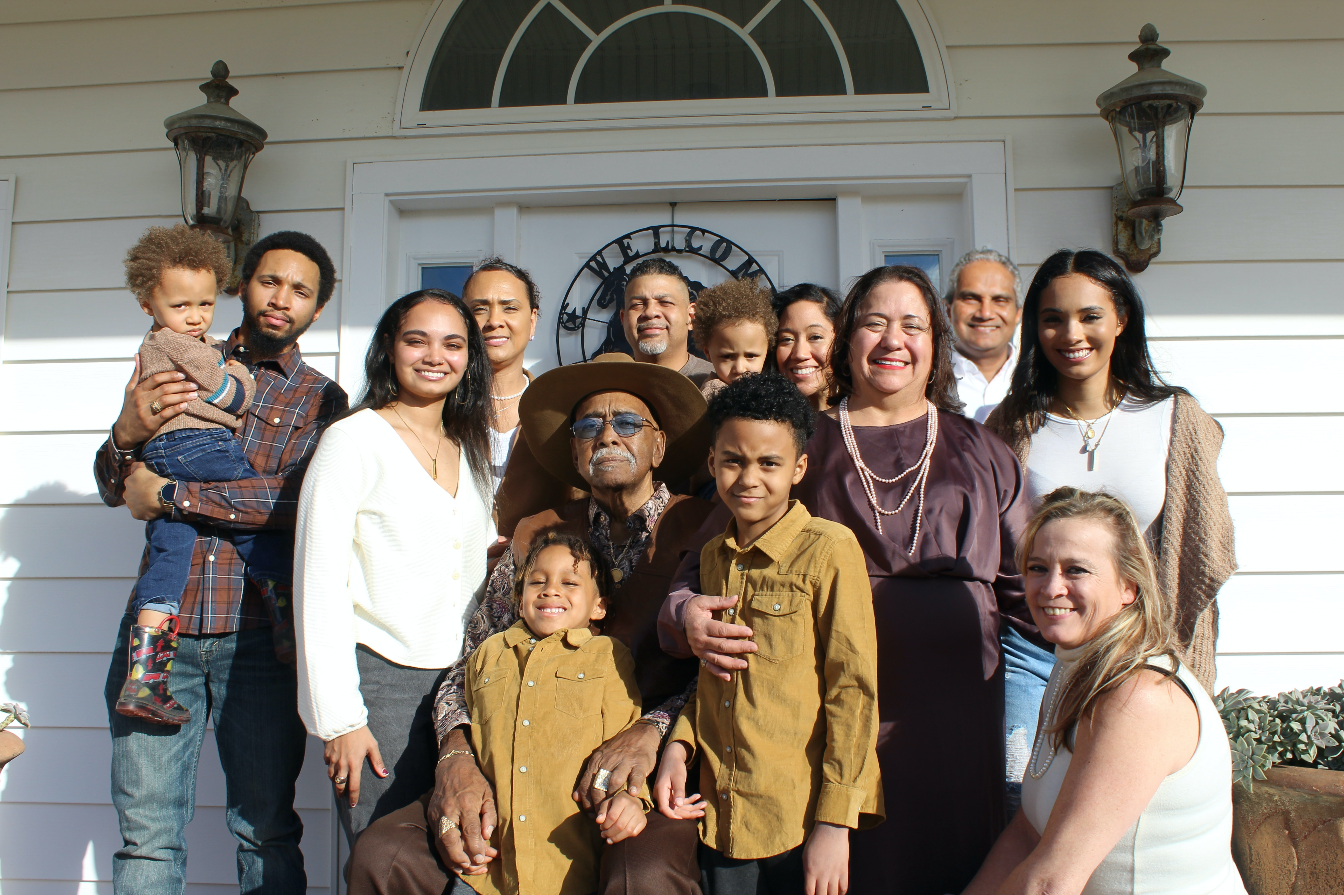

Slide 14
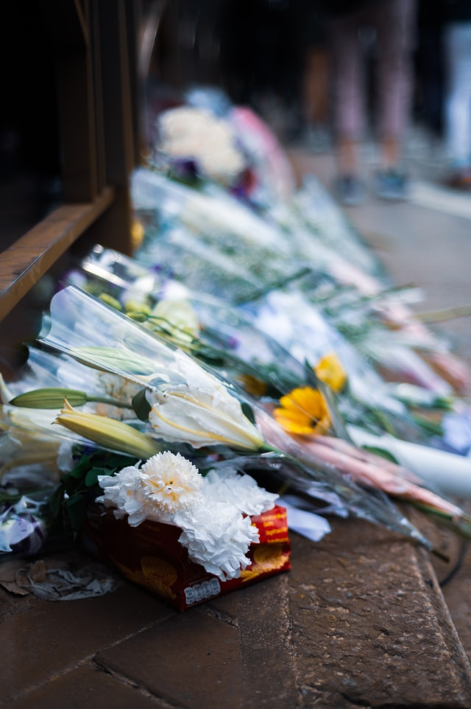

Slide 15
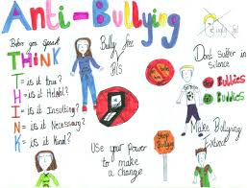
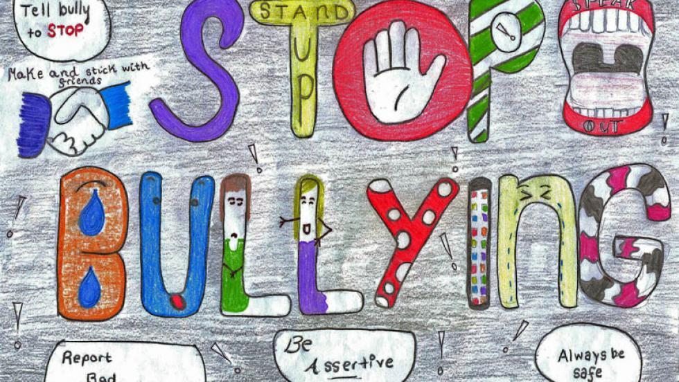

Slide 16
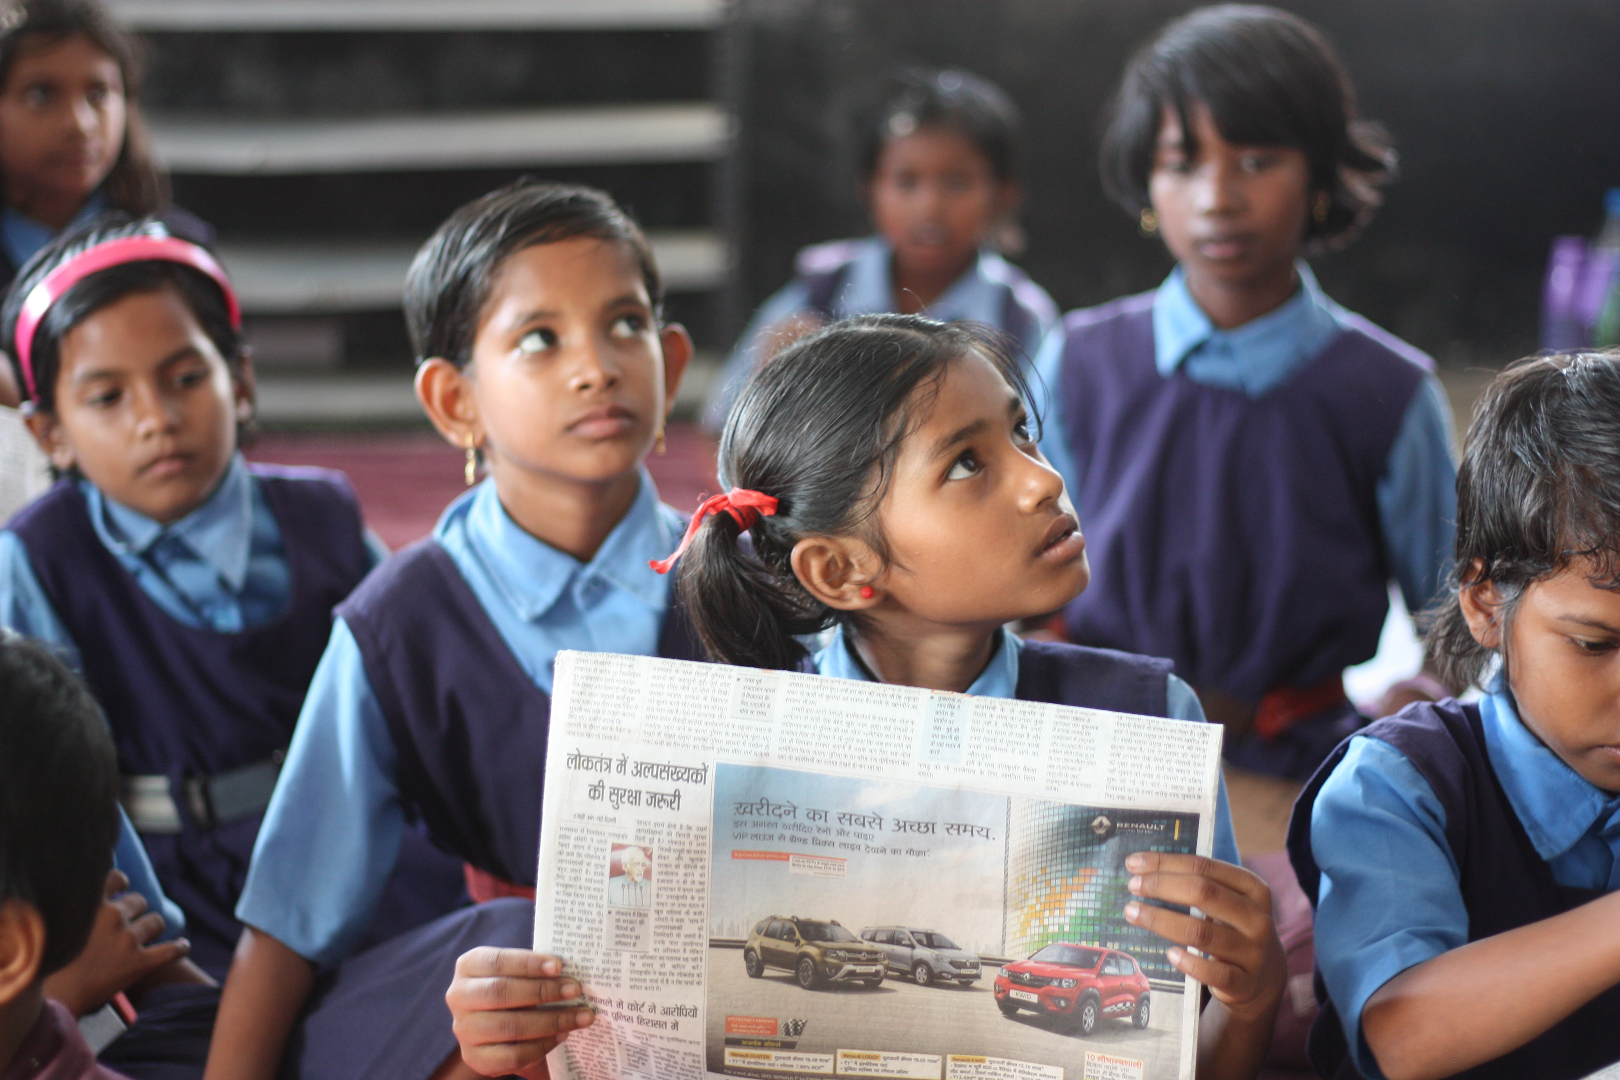

Slide 17
• Why is it respectful?
• What might be the feelings of the people in each scenario?
• How did this image make you feel?
Questions for each image

Slide 18
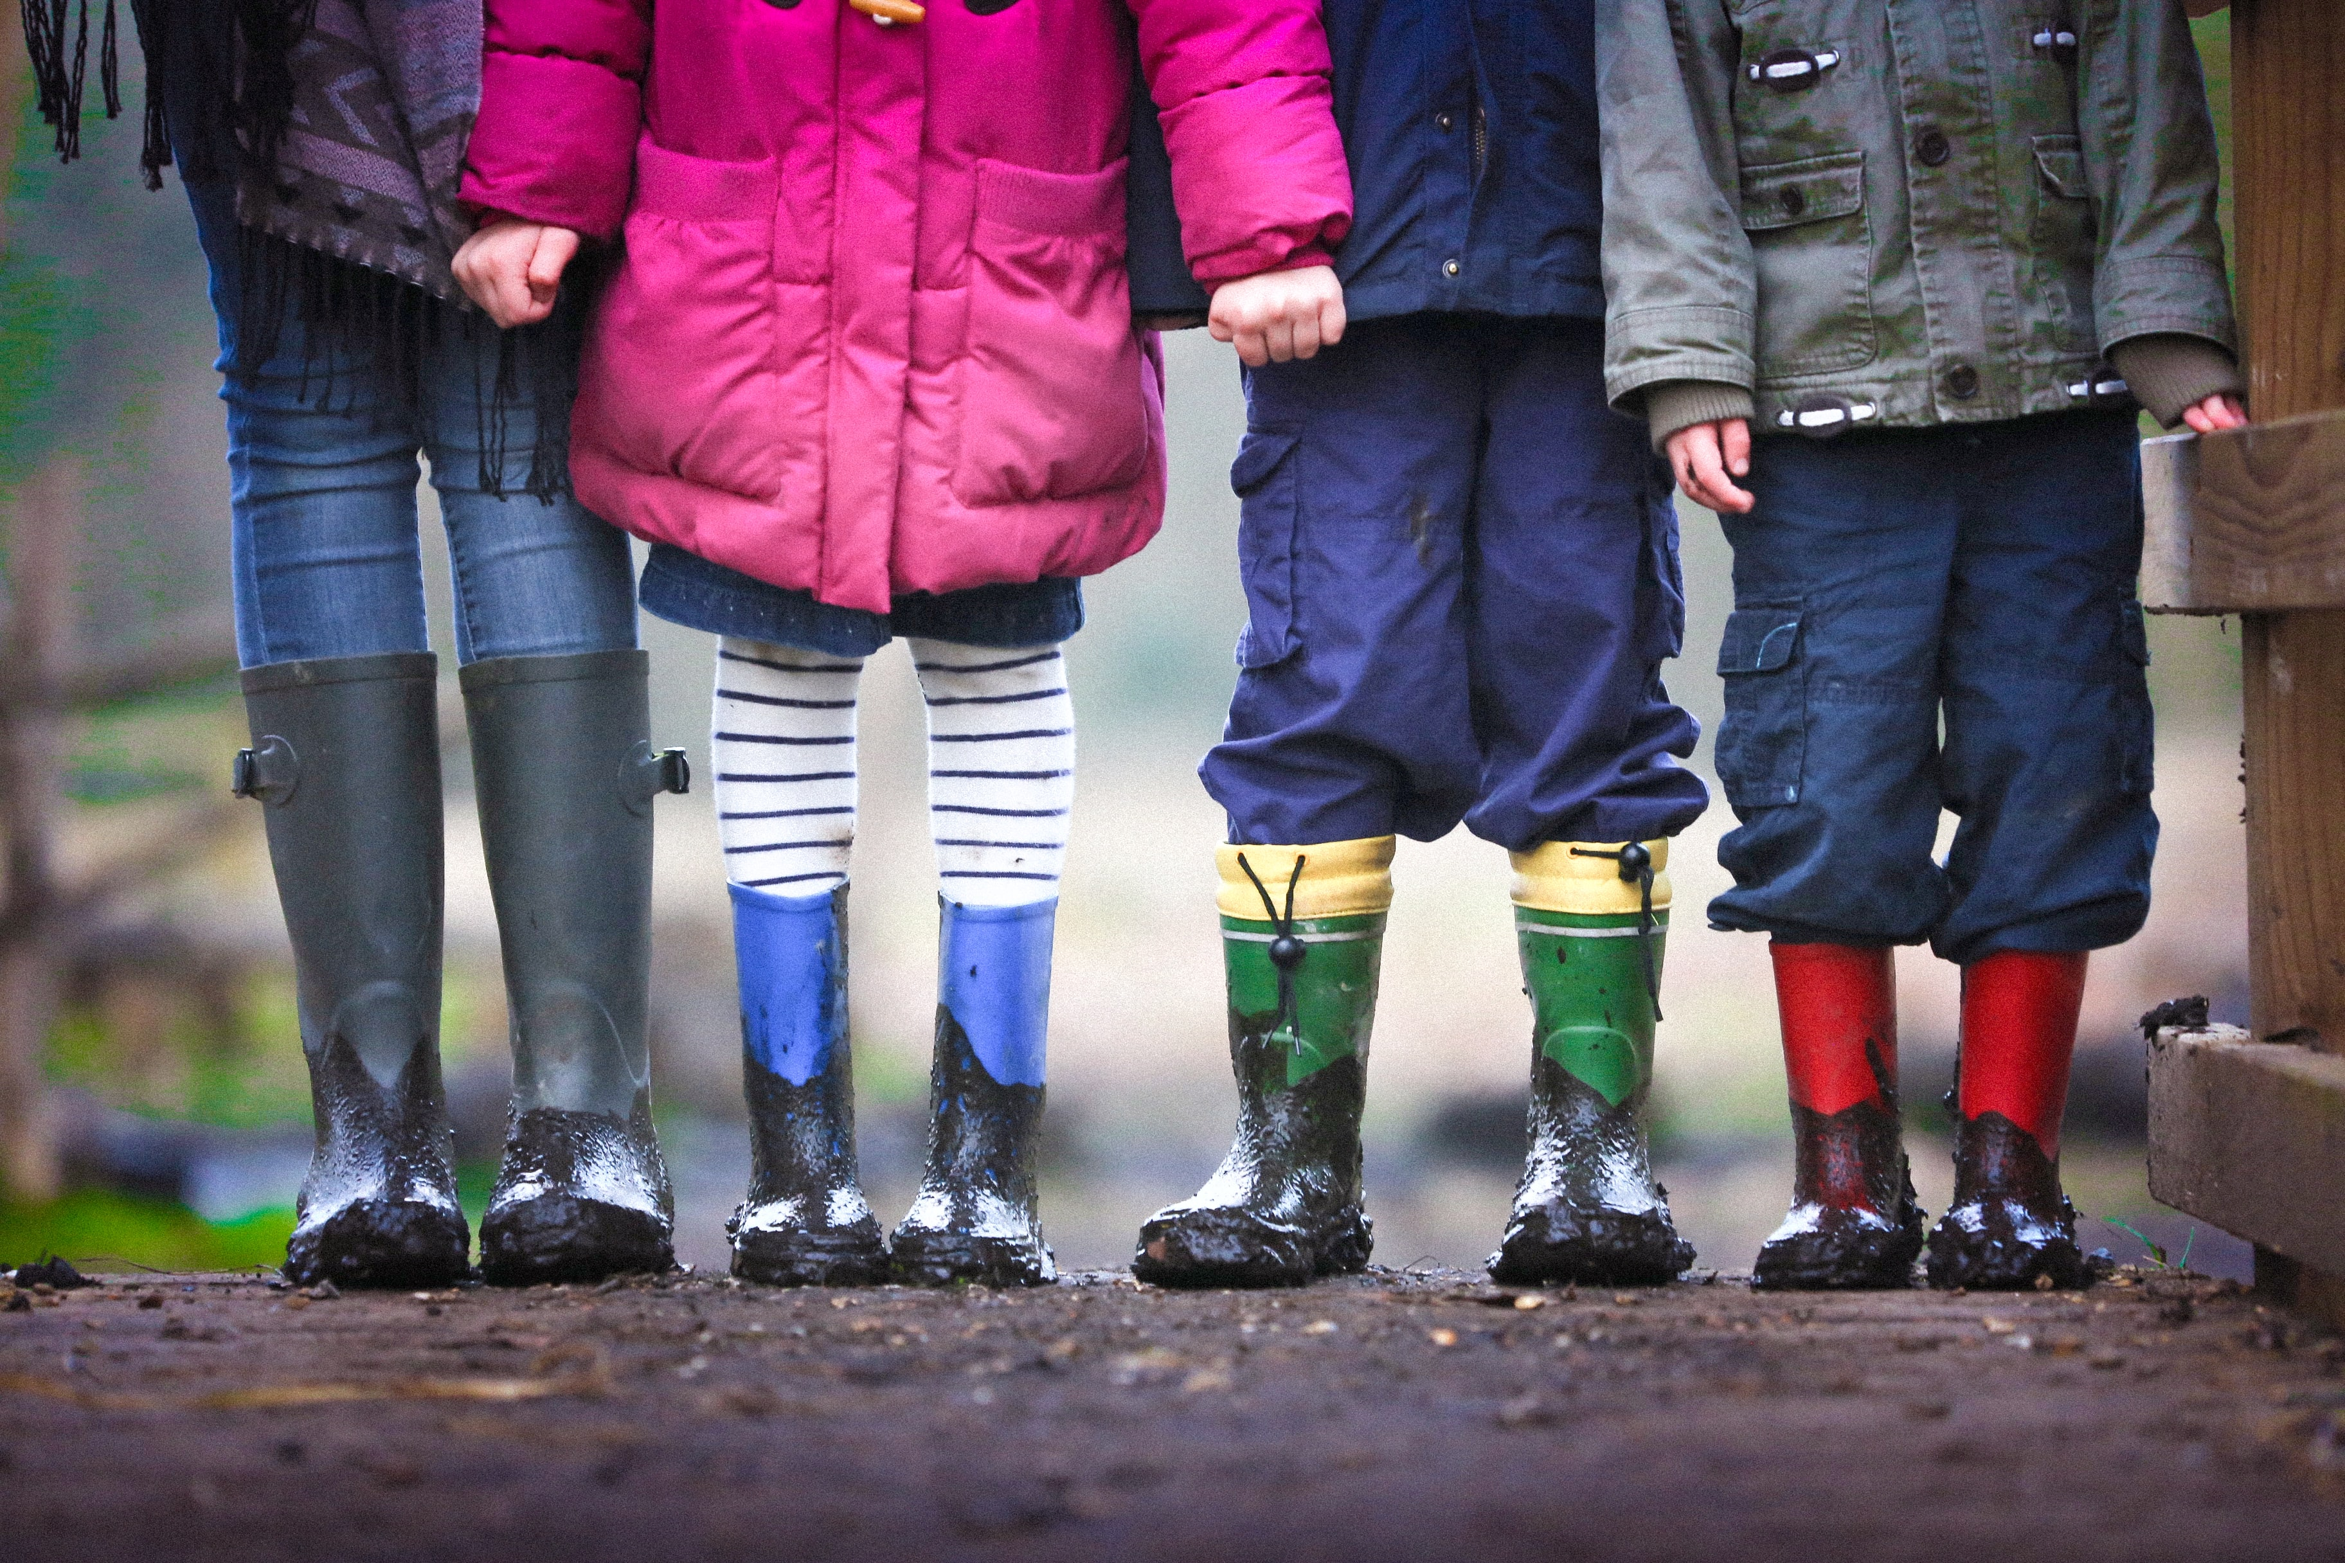
Appreciating Difference
Difference is something to be celebrated.
By appreciating difference and celebrating our identities we are showing respect for each other.
Appreciating Difference
It is hard to show respect for others if we don’t understand them. By giving time to understand others, we are showing respect for them.
When we find similarities between each other we build understanding.

Slide 19
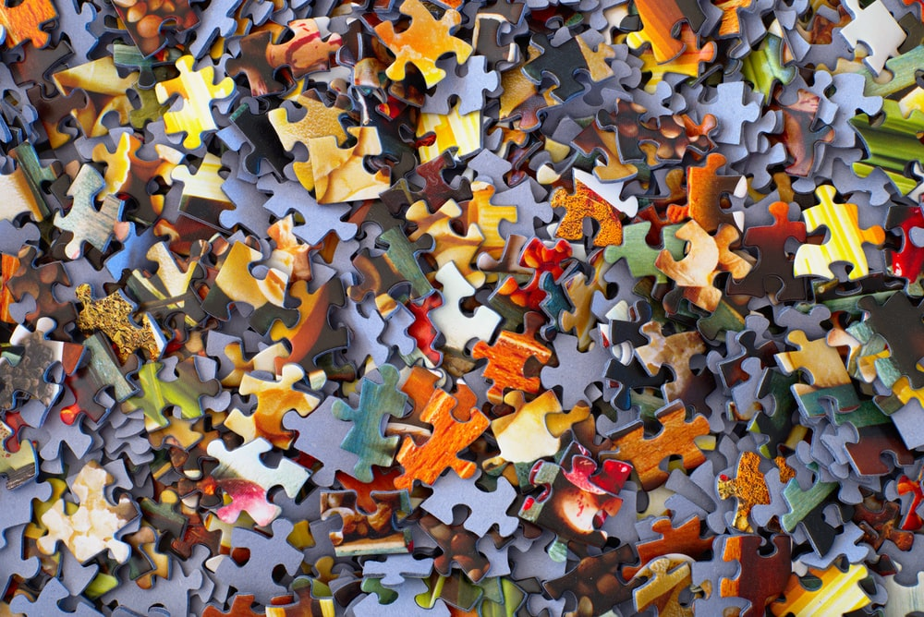
Activity 3
Class Jigsaw!

Slide 20
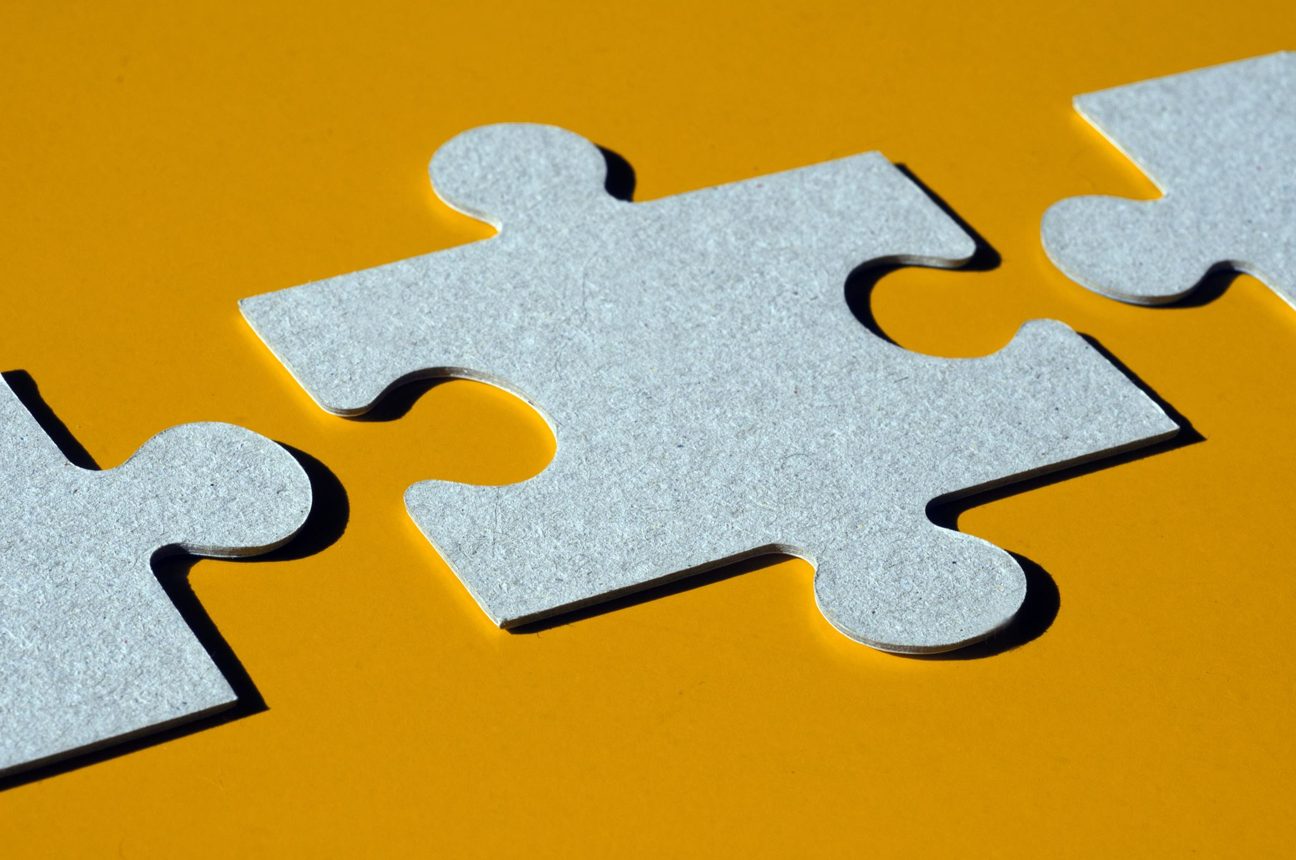
Write or draw on your puzzle piece some of the below:
• A favourite interest or hobby
• Favourite subject at school
• A special object / belonging you have
• Something about your personality
• A special place
• Favourite fruit

Slide 21
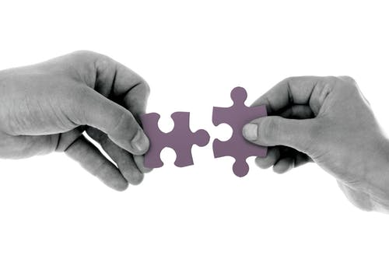
Piecing it together
Activity 4 – Piecing it together!
We can see that we, all like the puzzle pieces, fit together, as we can see we all have our own personal interests and things that are important to us but many other things in common
If we understand each other more it means we are better equipped to show respect towards one another.
Part of respect itself is taking the time to understand each other by having meaningful conversations.
In a multicultural world, we need to learn to respect each other so we can fit together in society. Just like the puzzle.

Slide 22
Did you find it easy/difficult to think about what to include on your puzzle?
Did you learn anything new about your classmates?
Did you find any differences/similarities?
.

Slide 23
Activity 5: Ask Your Neighbour!
Pair up and write down at least one thing about the other person that is a:
Similarity
Difference
Surprise

Slide 24
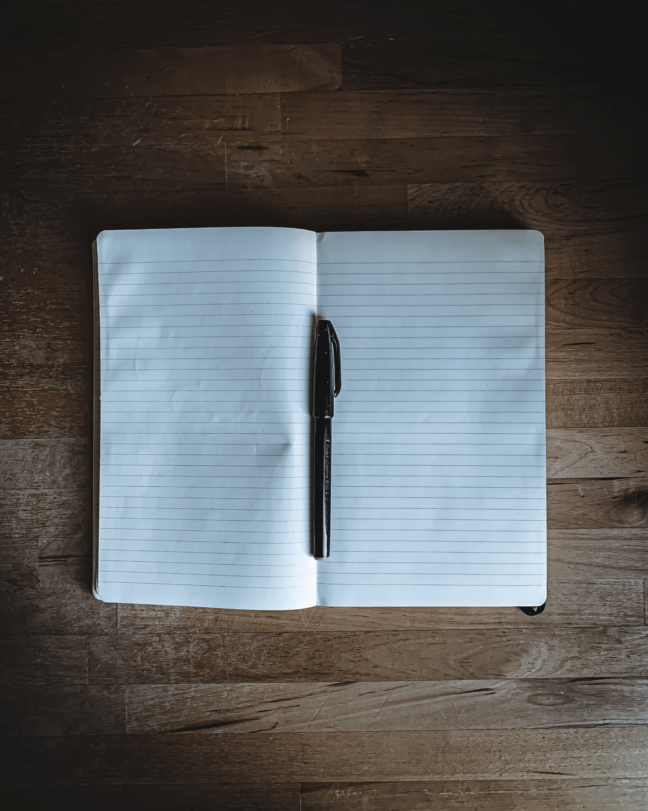
Written work
How did this activity help you respect your classmates more?
Write down one thing you learnt today, one thing you will try to do every day to show respect to your friends.
Give one example of a way in which you would show respect to someone different to you.
.

Slide 25
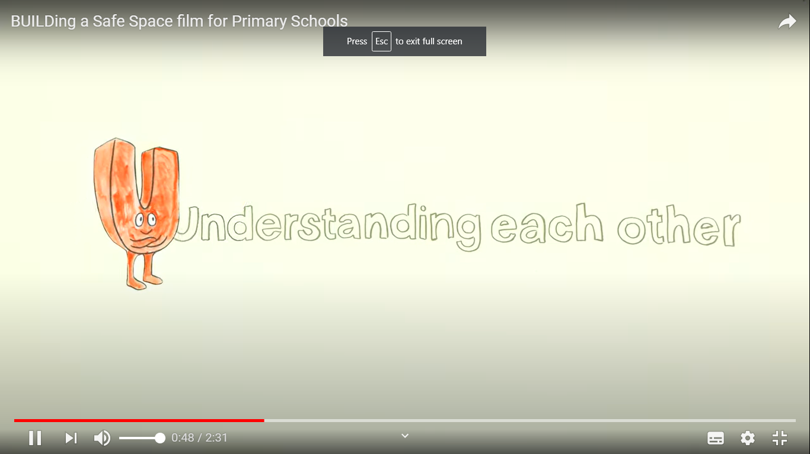
We will be exploring how one of the ways we can be respectful to each other is through understanding each other, by actively listening….
The next lesson is
U is for Understanding each other

