Slide 1
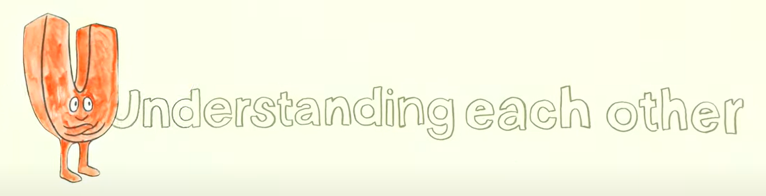

U is for Understanding each other

Slide 2

Today we are going to
Understand that in order to understand someone, we need to really listen to them
To better understand someone, we need to 'actively' listen

Slide 3
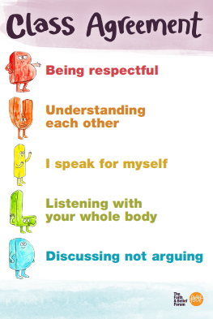
Our Class Agreement or BUILD

Slide 4
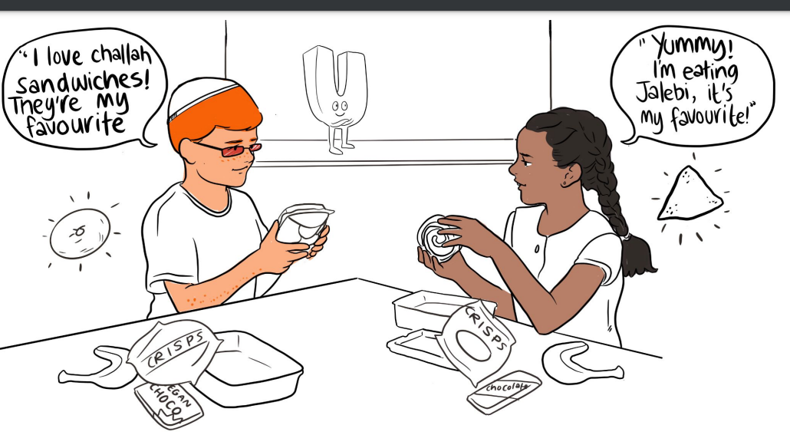
Watch the Safe Space Film and stop at this scene!
What items in each child’s lunch is the same and what is different?
What is showing that the children are really listening to each other?

Slide 5






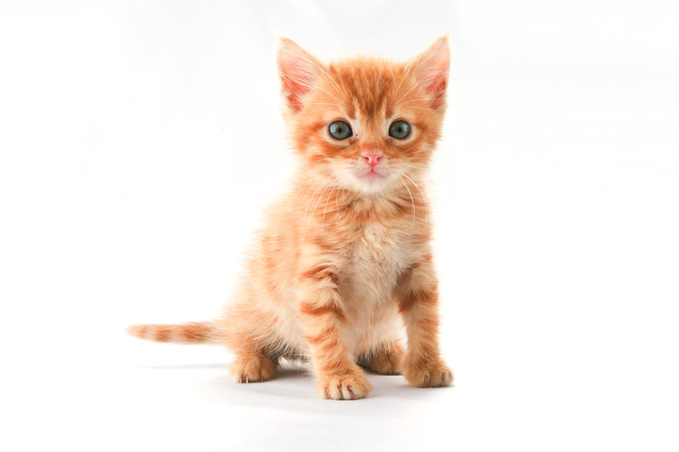

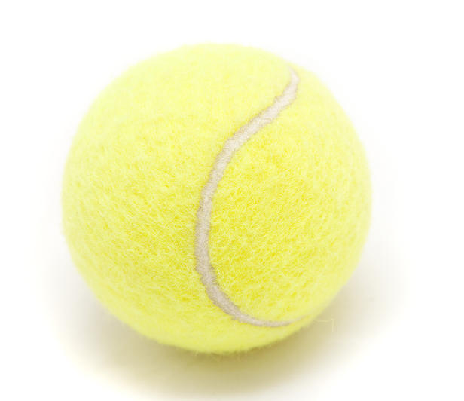
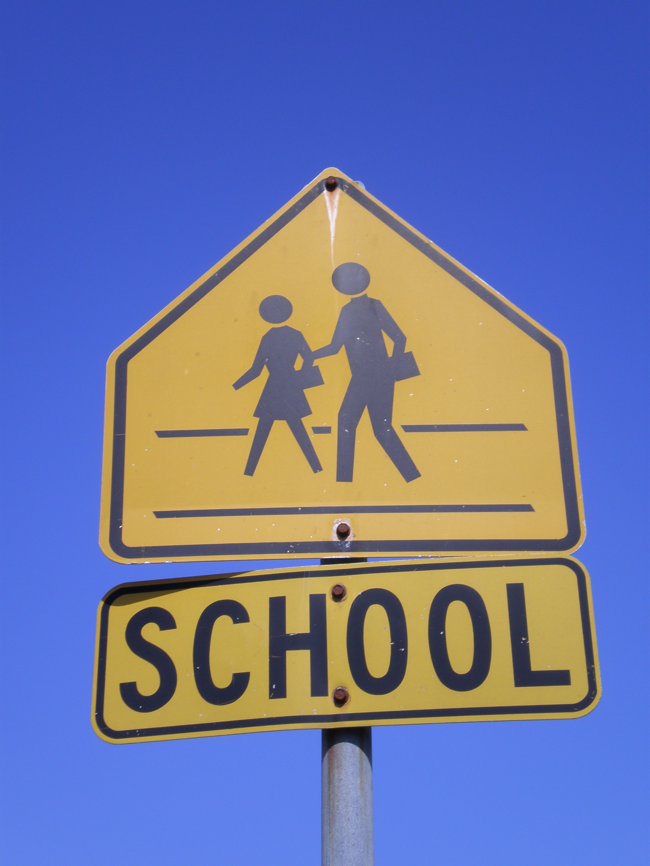
Activity 1: Likes & Dislikes

Slide 6
Activity 1: Likes and Dislikes!
Pair up and share something you like and something you don’t like with your partner.
For example: ‘’I like playing football but I dislike eating fruit’’ with the person sitting next to them. Model examples from the prompt topics on the PowerPoint.
Then swap partners with another pair on their table and share with them their likes and dislikes and their original partners likes and dislikes.

Slide 7
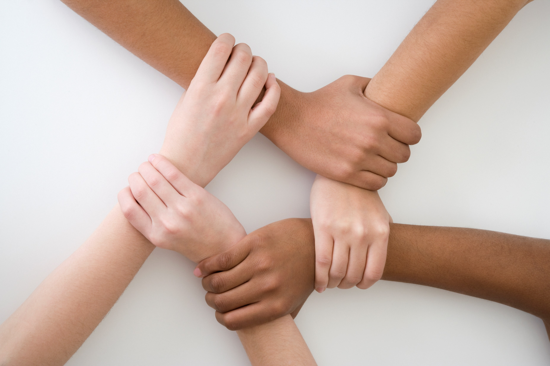
Hands up if…..
1. You learnt something new about someone else?
2. You felt you were really listening to each other?
3. You found it hard to remember what everyone had said?

Slide 8


What do you think it means to ‘actively’ listen?

Slide 9

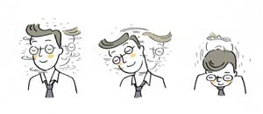


How can we make sure we listen actively?
Eye contact
Nodding
Body language
Asking open questions
Repeating back

Slide 10
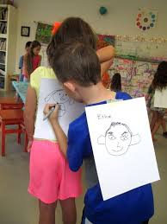
Activity 2 – back to back drawing
Activity 2: Back to Back drawing!
In pairs, one student to describe an image to their partner, and the other has to draw it.
TIP: asking questions helps!
Then swap around!

Slide 11
Activity 2: Back to Back! Questions
Was it easy to do? Why/Why not?
Did the person drawing ask questions to make sure they understood?
What the describer was telling them to draw?
Did the drawer listen actively to the describer?
Did the describer ask any questions to the drawer to see if they needed more description?

Slide 12
Asking questions is important so you can clarify that you understand what you are being told.

Slide 13
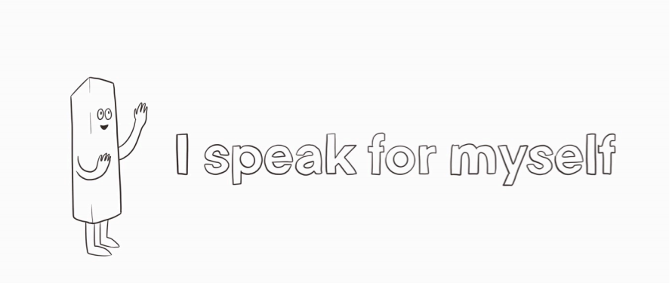
The next lesson is
The letter I

