Slide 1
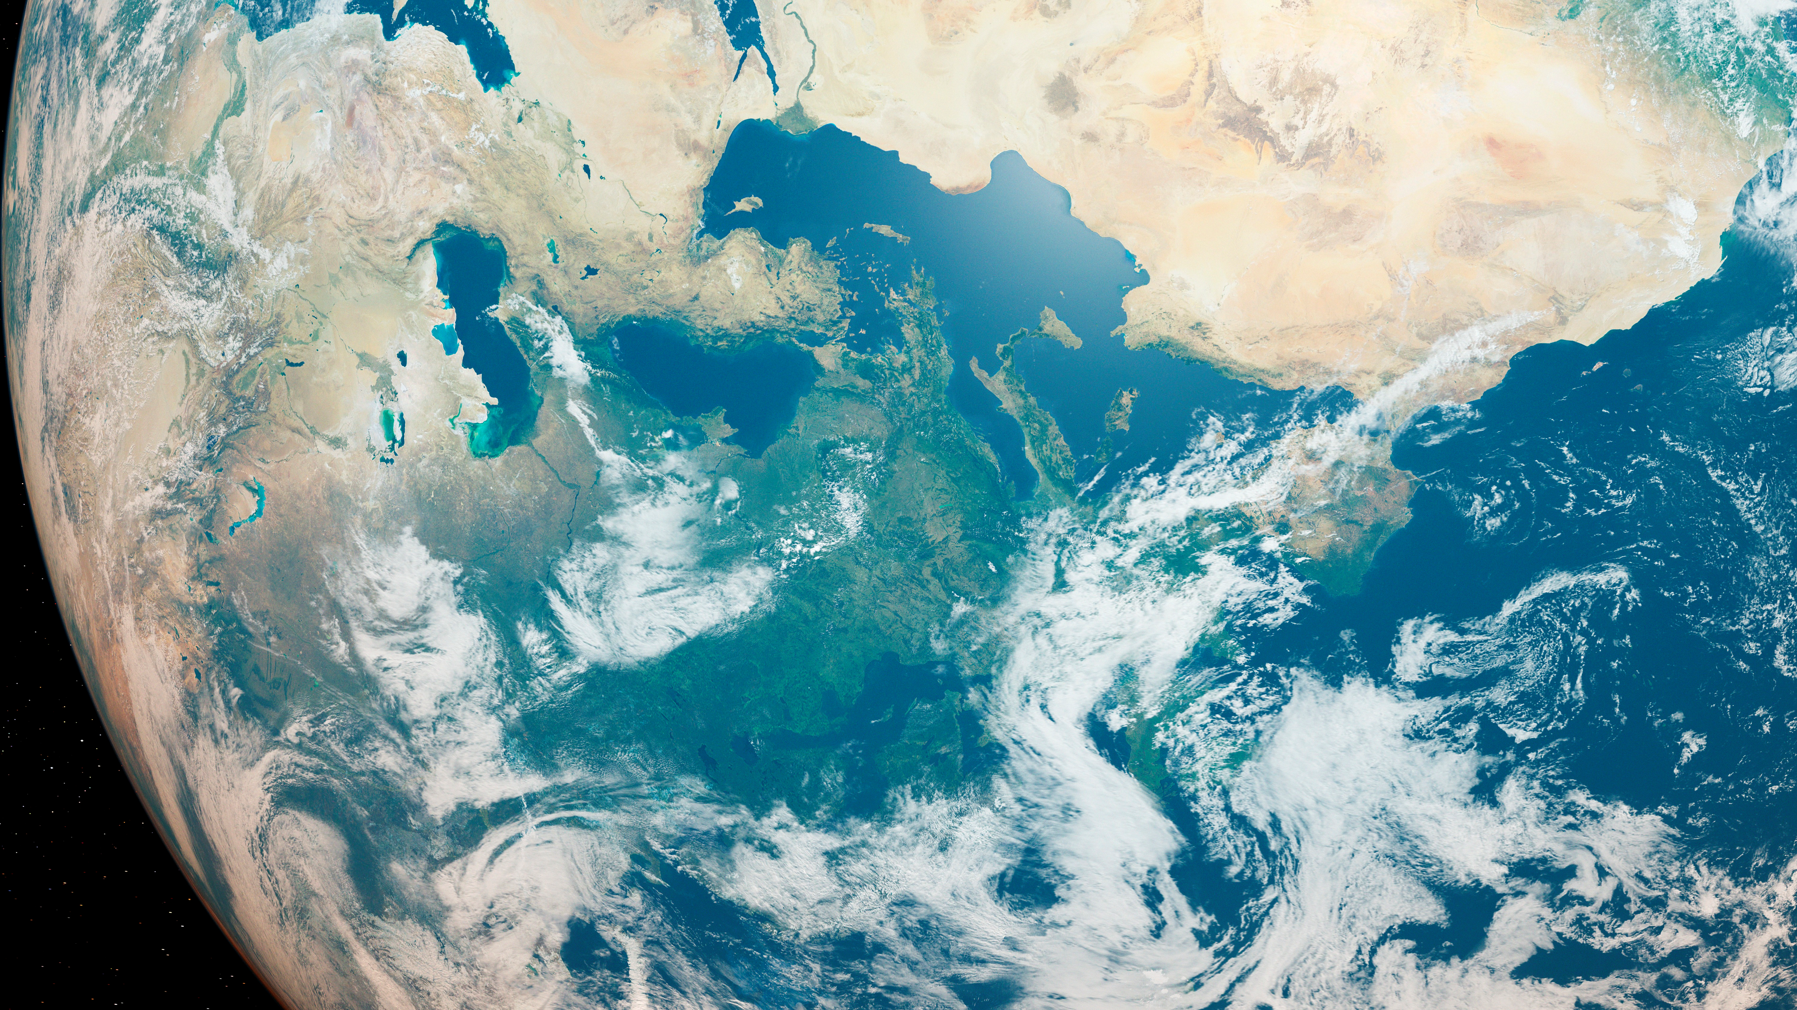

Part 3: We
Belief and the Environment
Values into Actions

Slide 2
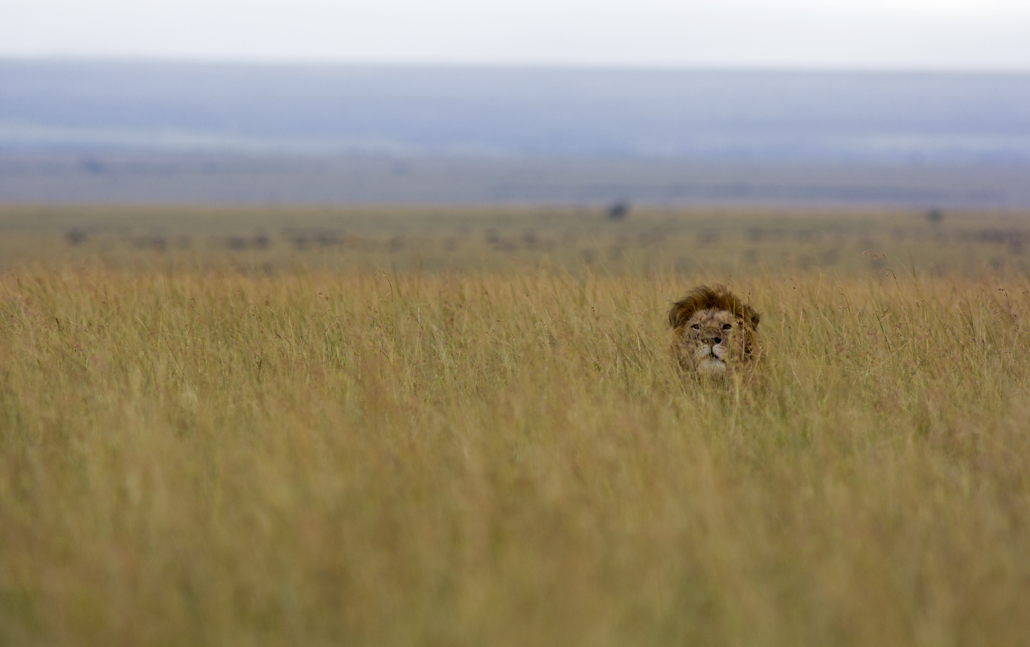

Objectives for this session
To explore the concept of collective action and how both religious and non-religious values can inspire people to act collectively for the climate.
To bridge the knowledge-action gap by joining up the ‘Me’, ‘You’ and ‘We’ sections and thinking about our identities and beliefs on an individual and collective level.
To take our work forward with ‘Belief and Environment’ ambassadors at school.
Key words: Collective Action, Interfaith, Dialogue
Notes:
We want to recognise that we are motivated and inspired in different ways, and celebrate that in our classroom.

Slide 3
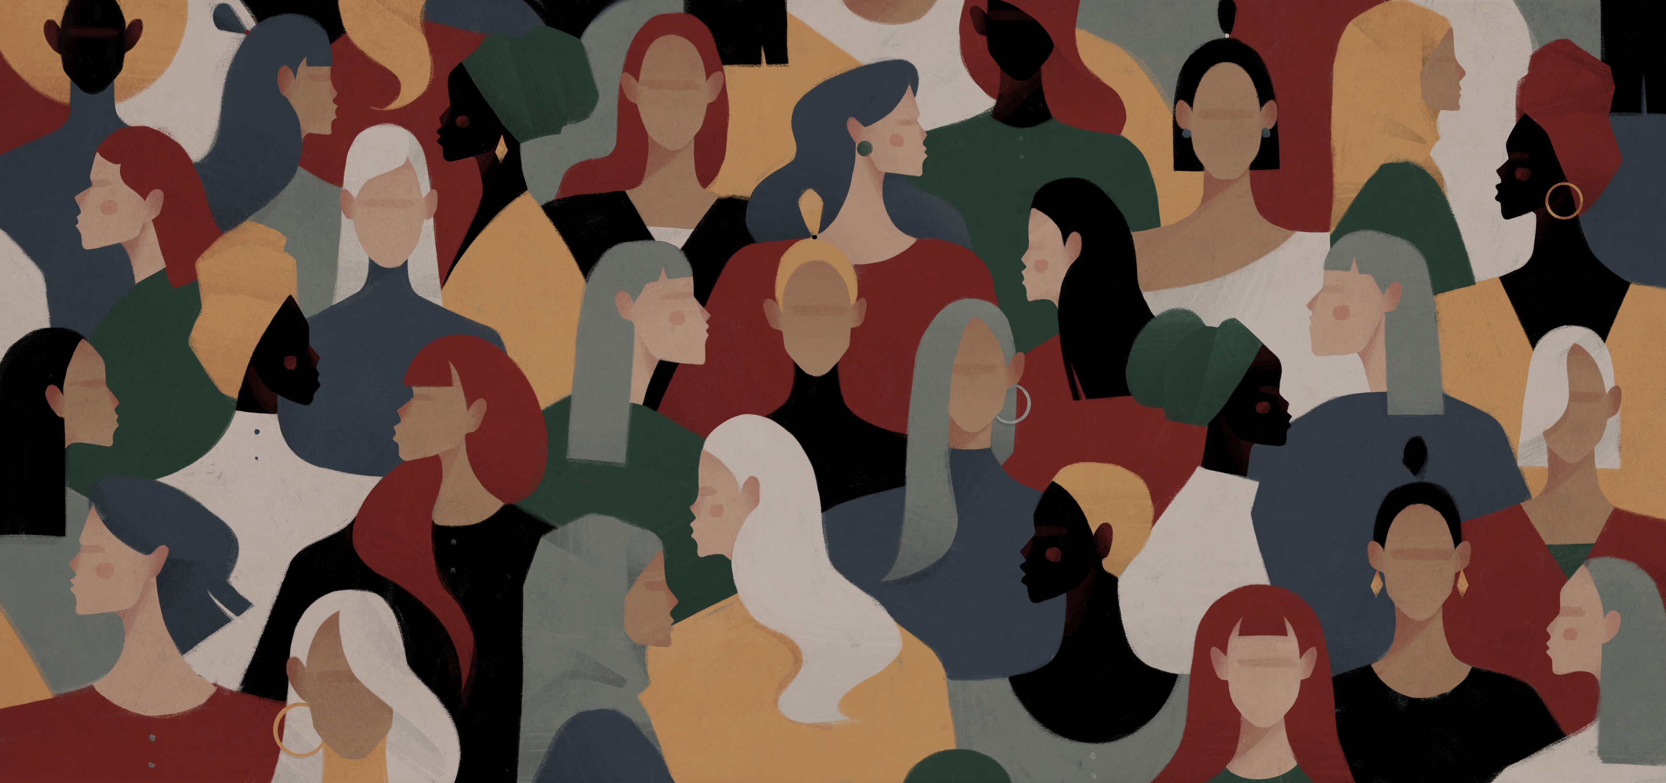
What is collective action?
Action which is taken together by a group of people who all want to achieve the same goals.
They may come from different backgrounds, and be motivated by different things, but they all care about the same problem and want to make an impact. They see that the best way to do this is as part of a bigger movement.
The actions they take could include social movements, community initiatives, protests or striking.

Slide 4
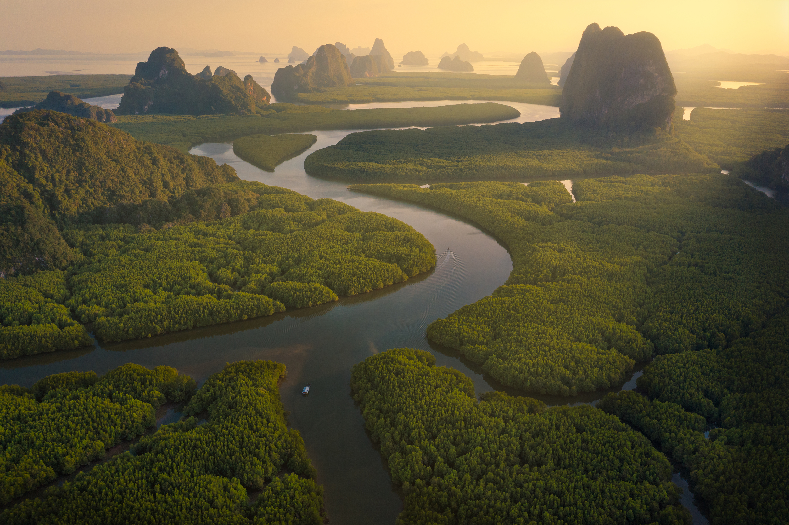
Example of collective action: Interfaith Rainforest Initiative
“The Interfaith Rainforest Initiative is an international, multi-faith alliance that aims to bring moral urgency and faith-based leadership to global efforts to end tropical deforestation. It is a platform for religious leaders to work hand-in-hand with indigenous peoples, governments, civil society and business on actions that protect rainforests and safeguard those that serve as their guardians.”
Their three main goals are to:
Raise awareness
Mobilise action
Influence policy

Slide 5
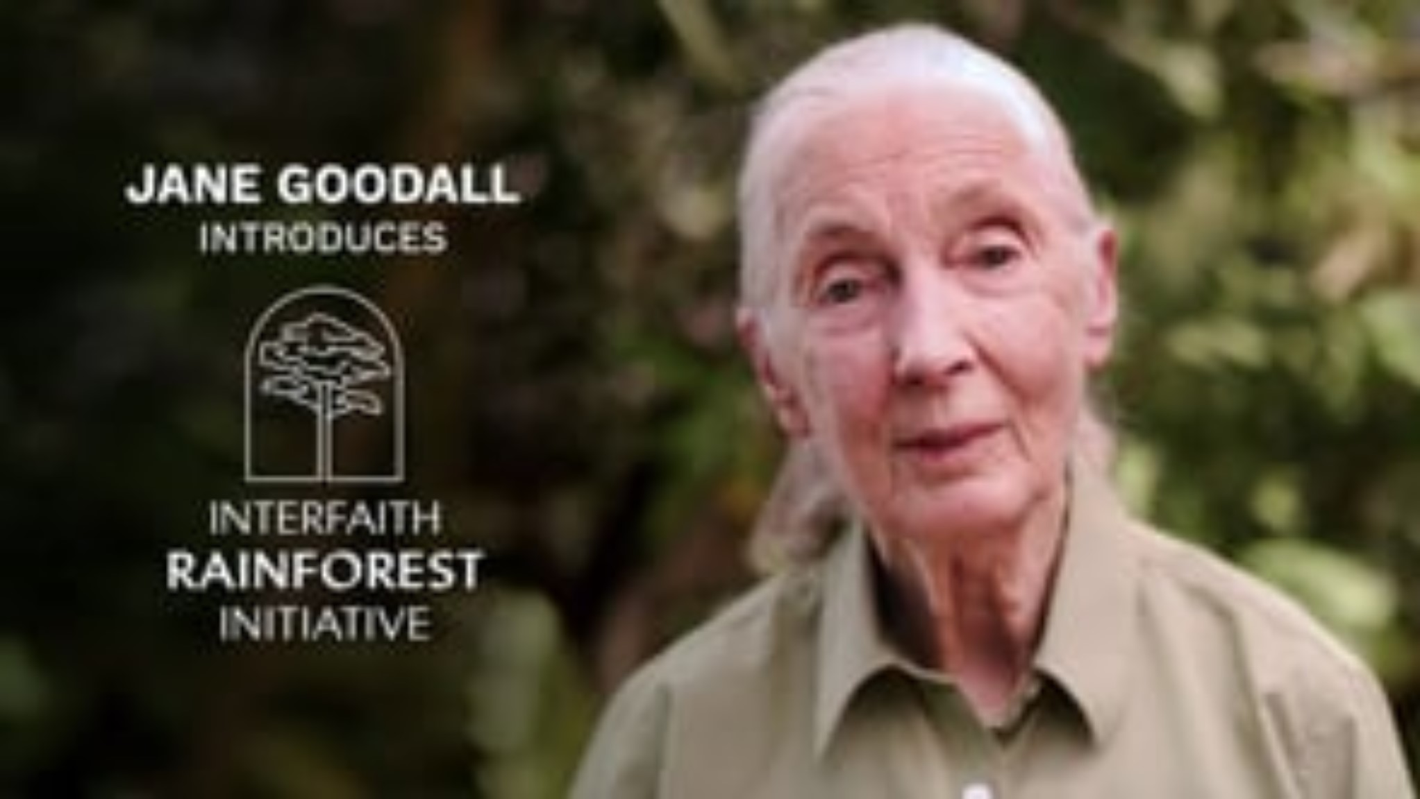

Slide 6
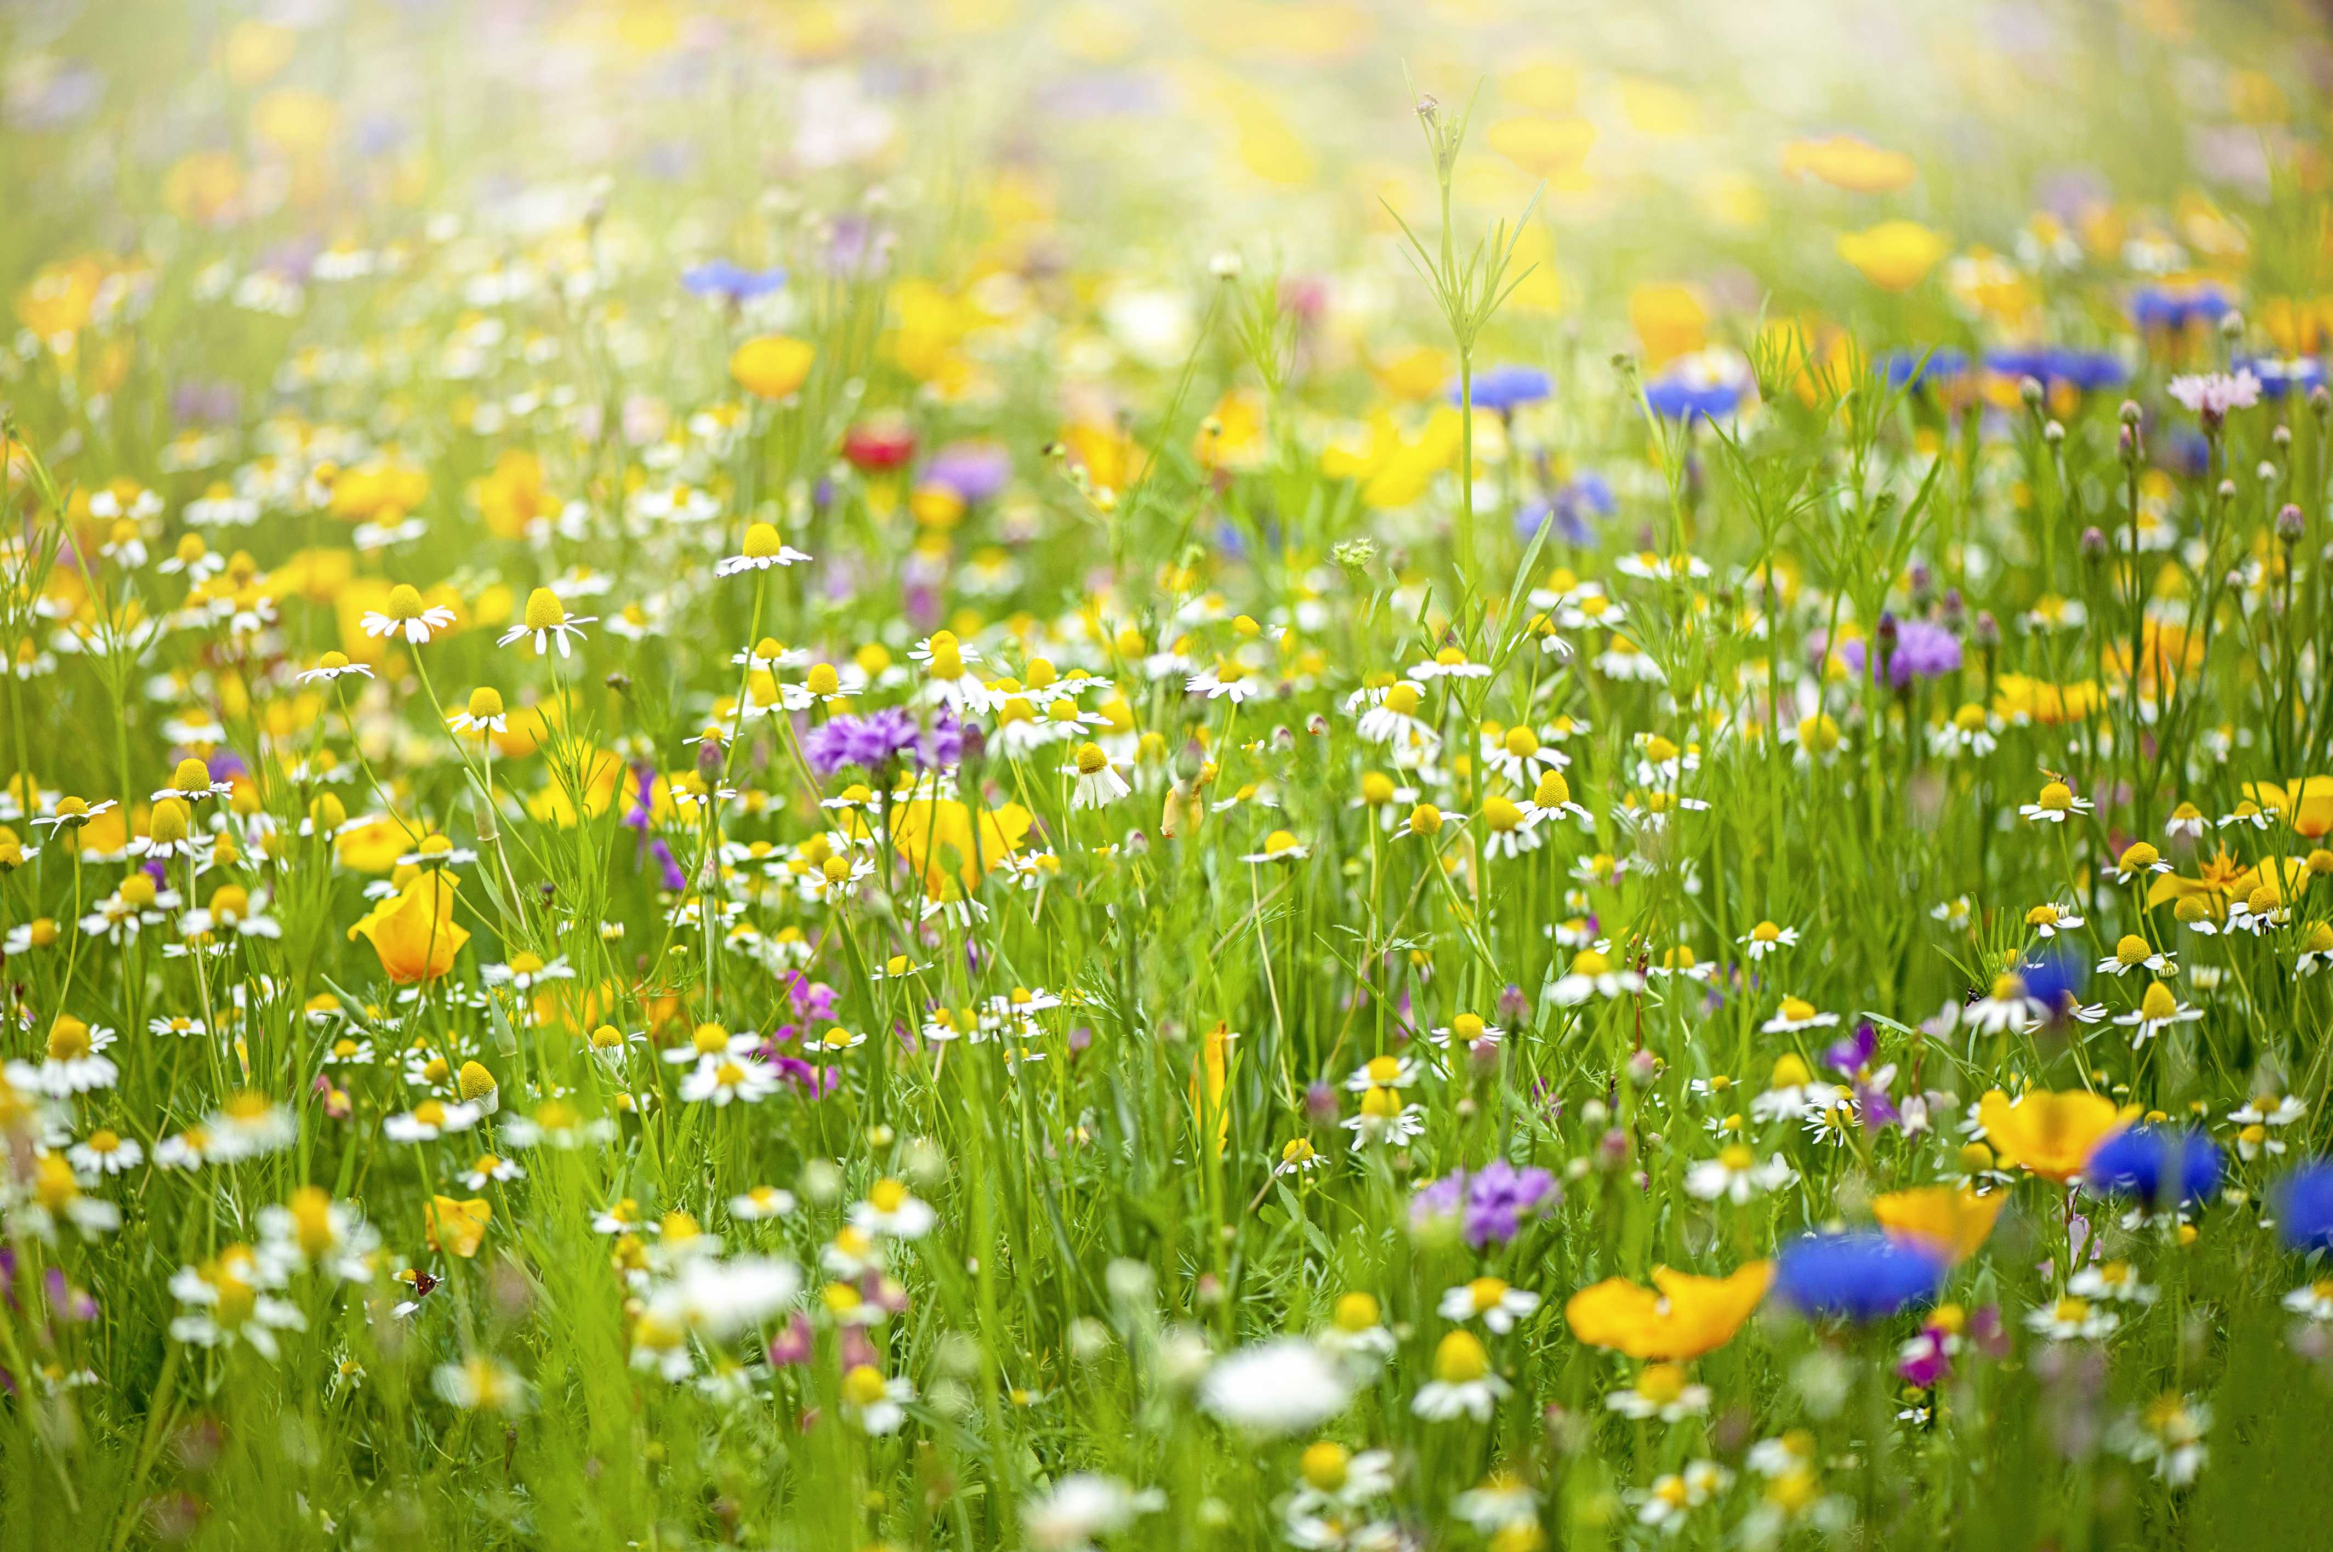
Example of collective action: Fridays For Future
“#FridaysForFuture is a youth-led and -organised movement that began in August 2018, after 15-year-old Greta Thunberg and other young activists sat in front of the Swedish parliament every schoolday for three weeks, to protest against the lack of action on the climate crisis. She posted what she was doing on Instagram and Twitter and it soon went viral.”
“The 2019 Global Week for Future was a series of 4,500 strikes across over 150 countries, likely the largest climate strikes in world history, the 20 September strikes gathered roughly 4 million protesters, many of them schoolchildren. On 27 September, an estimated two million people participated in demonstrations worldwide.”
People from all different backgrounds and ages have been motivated to act for the climate and be part of a global movement.

Slide 7
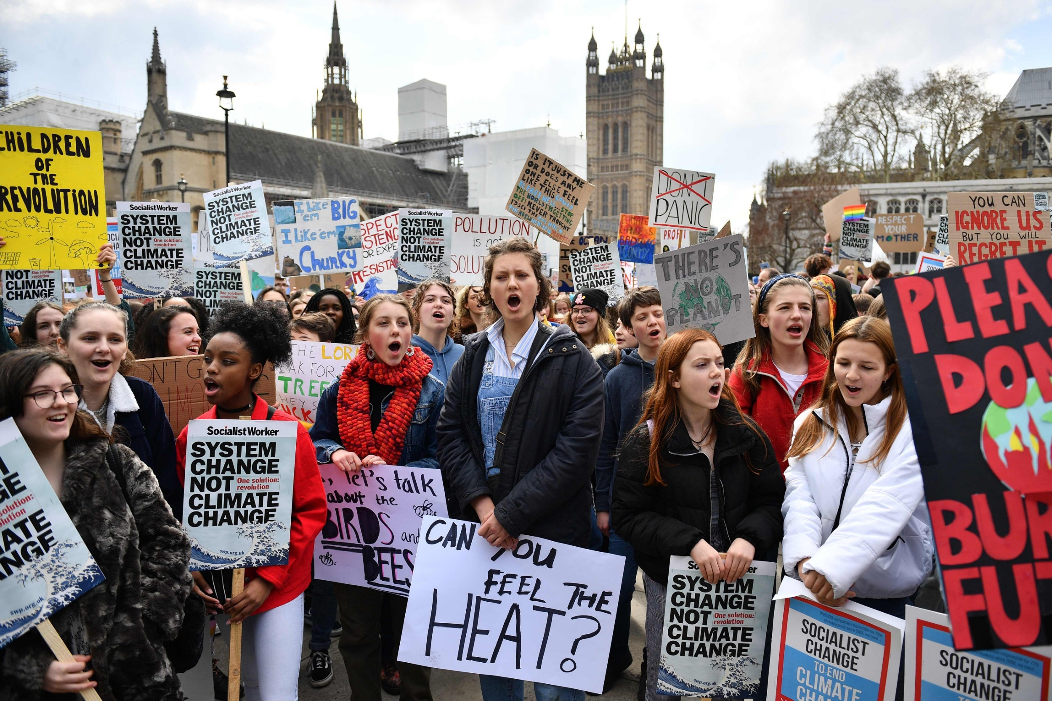

Slide 8
Collective action
What does my story bring to our collective action as a class?

Slide 9
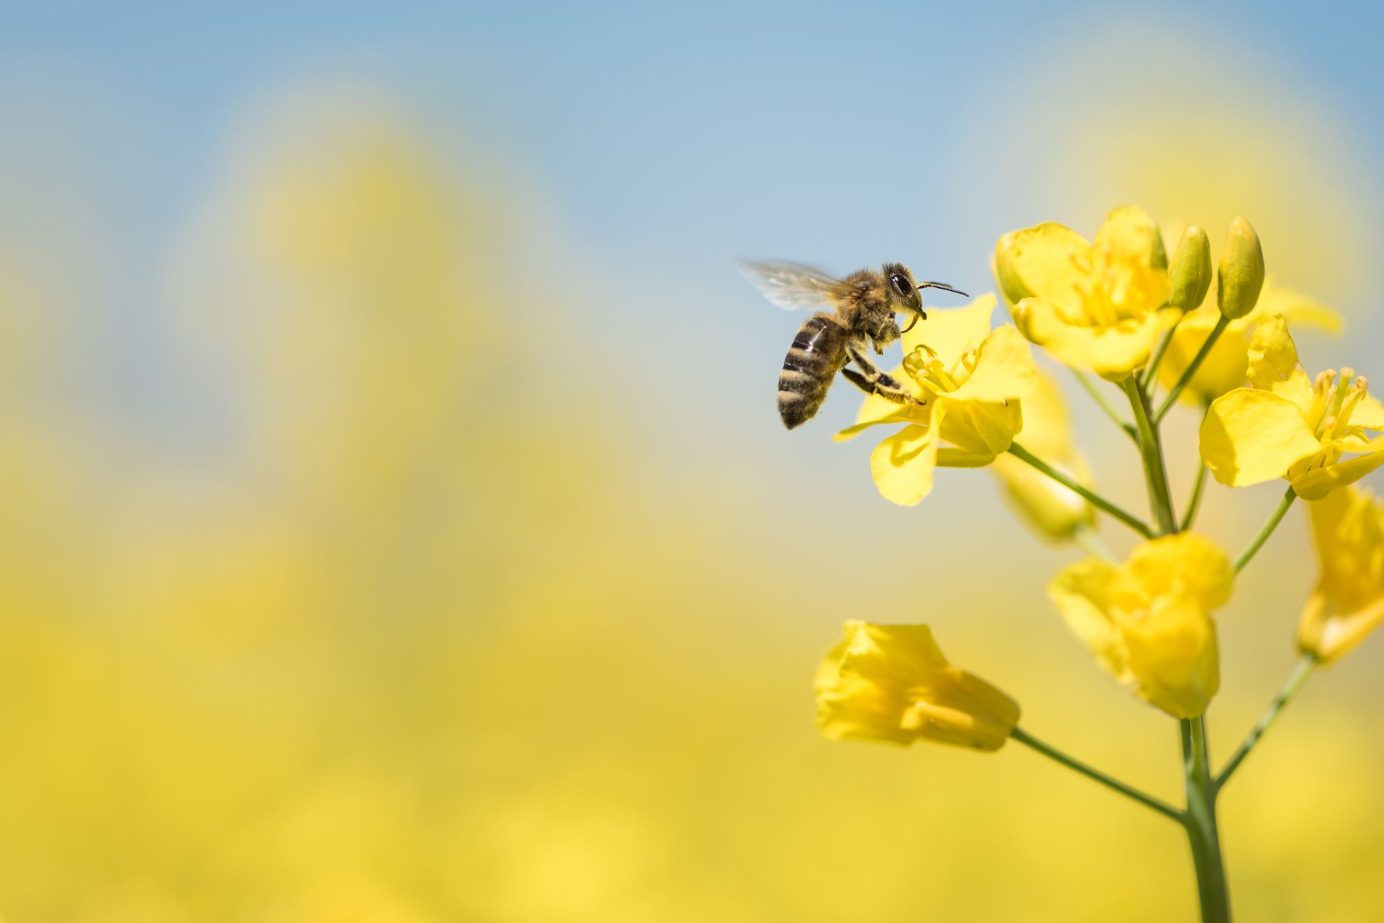
Creating our Class Manifesto
Remember that we don’t all have to be inspired or motivated by the same things! We can have different beliefs, values, experiences and feelings and work together towards a common goal; in fact, our diversity makes us stronger.

Slide 10
Volunteer to be a Belief and Environment Ambassador!
To represent the values of your class, making sure that your project is inclusive to, and led by, the diversity of faiths and beliefs that are present.
To ensure that your project is carried out beyond the ‘idea’ stage into the ‘doing’ stage.
To work together to create realistic goals and timelines that will create a positive impact for the environment.
To gain skills in project planning and management, interfaith dialogue and social action that will benefit you in the future!

Slide 11

Feeling Cloud
After completing these three sessions and having a goal to work towards as a class…
How do you feel when you think about the environment and climate change?

Slide 12

The end of this session… but not The End.
It is important to put what we have covered in these sessions into practice and to carry out your class project together!
What are your first action points?
Who are your ambassadors?

