Slide 1
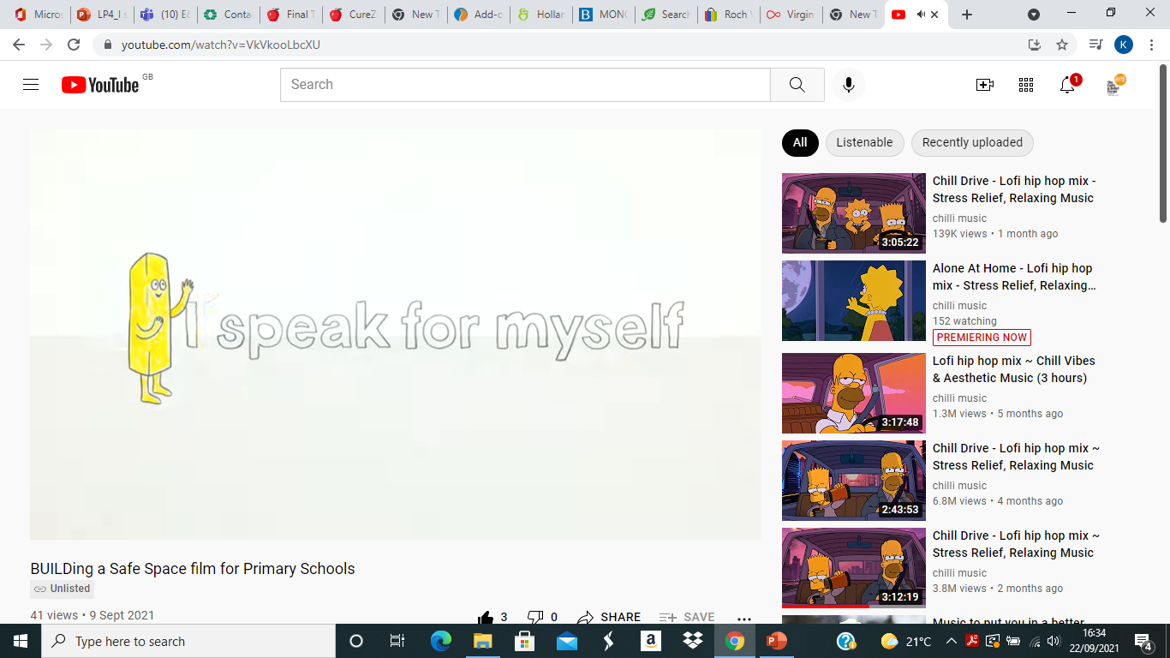

I is for I speak for myself

Slide 2
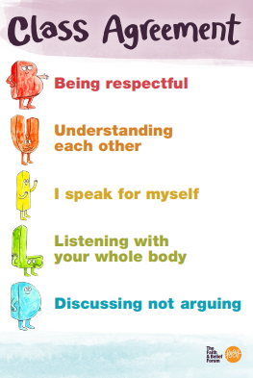
Our Class Agreement

Slide 3
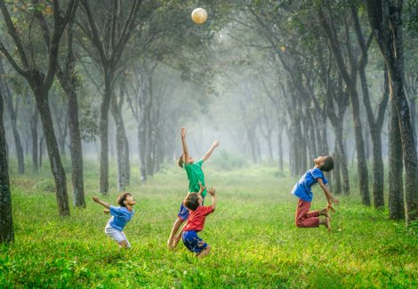
Activity 1: 'Clumps!'
Clear space to move around
You have 10 seconds to get into clumps of people who......

Slide 4

Born in the same month as you

Slide 5
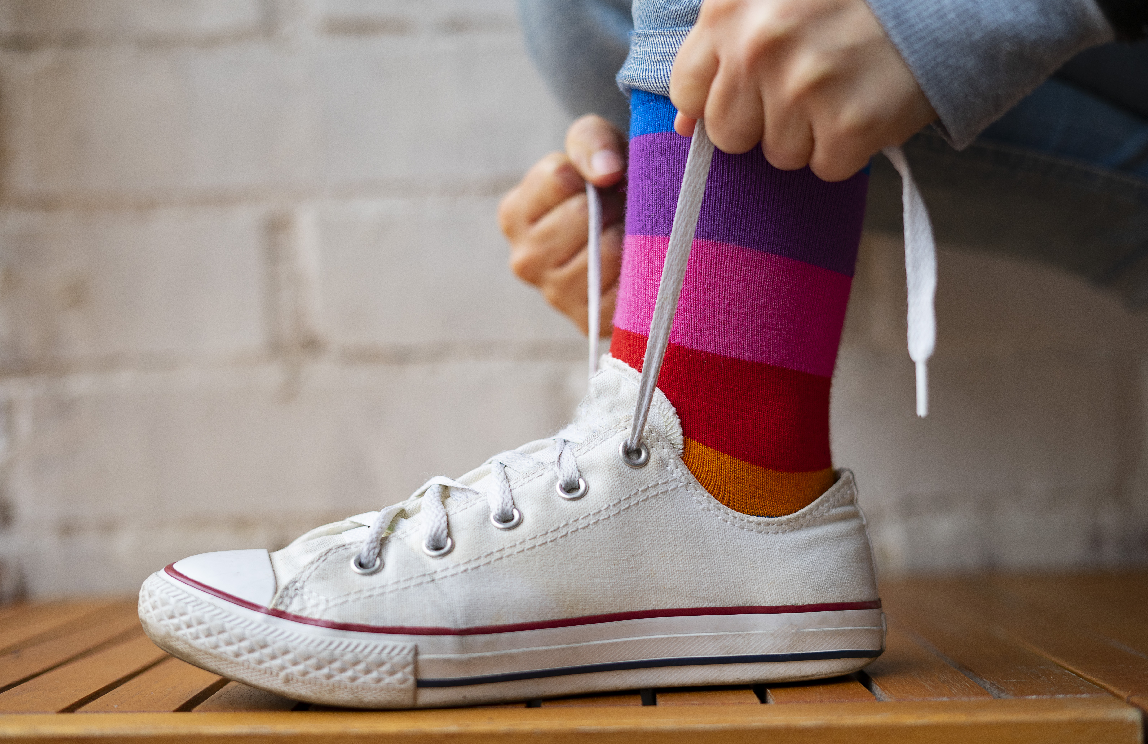
Same shoe size as you

Slide 6

Has the same favourite colour as you

Slide 7

Has the same favourite subject as you

Slide 8
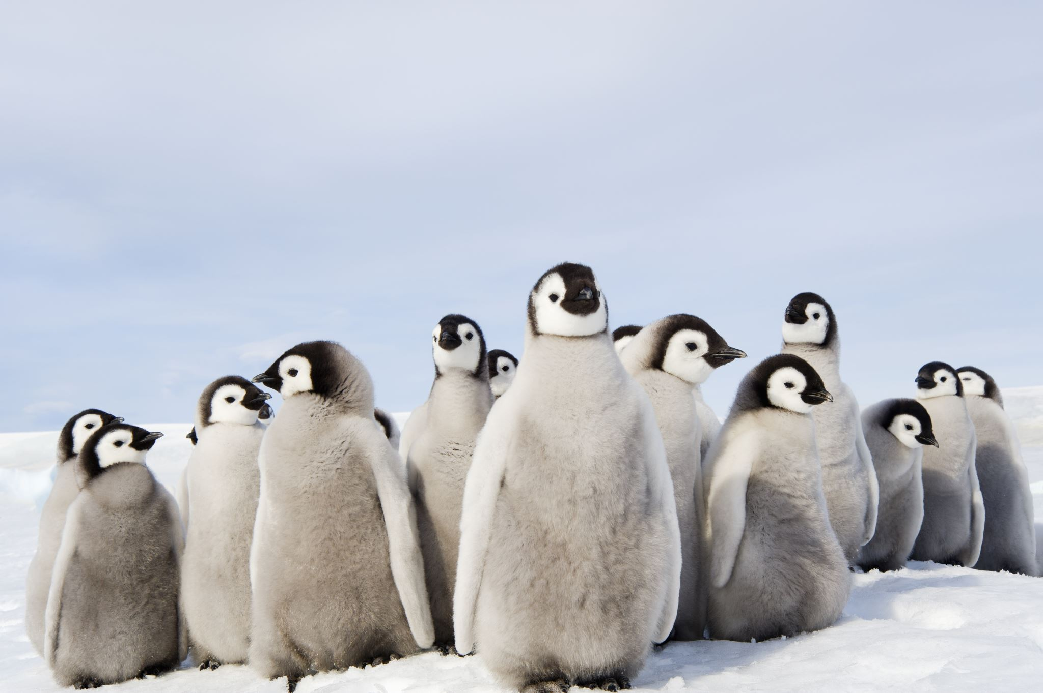
Has the same amount of brothers and sisters

Slide 9
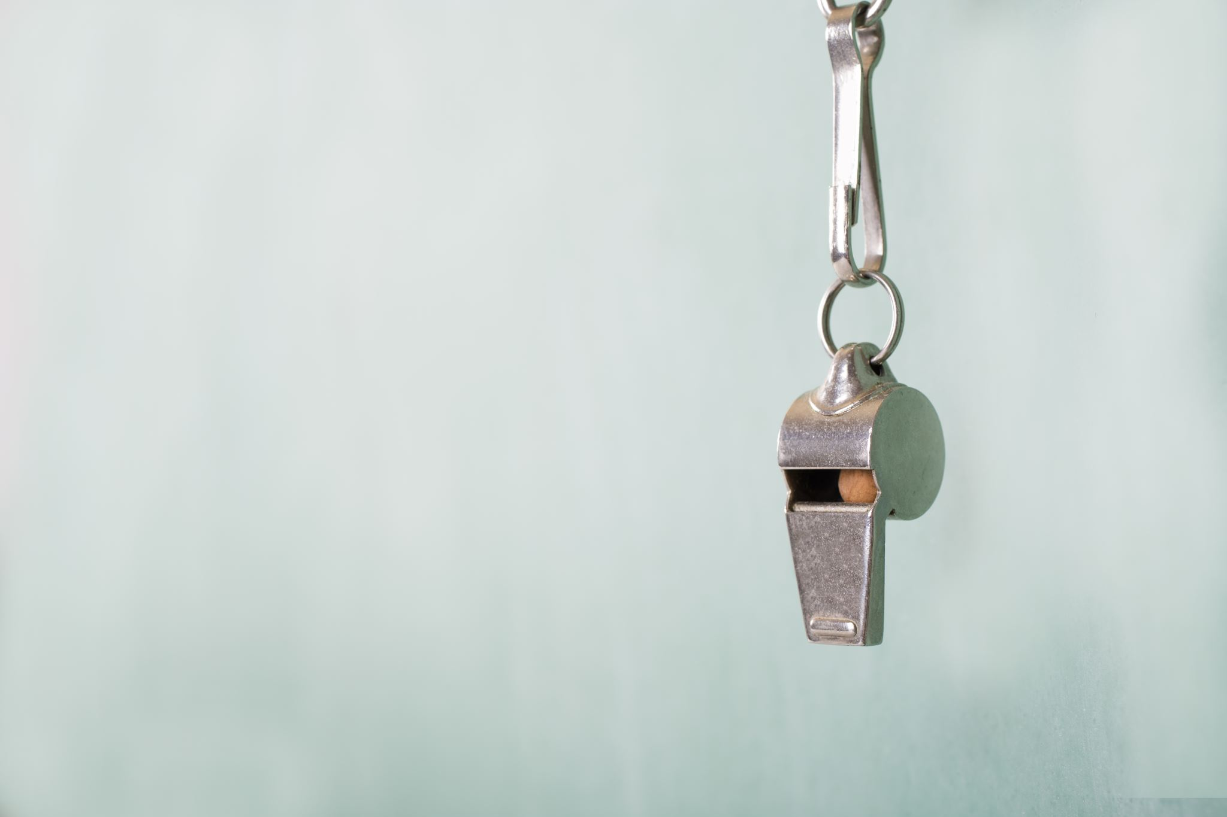
Does the same activity as you outside of school

Slide 10
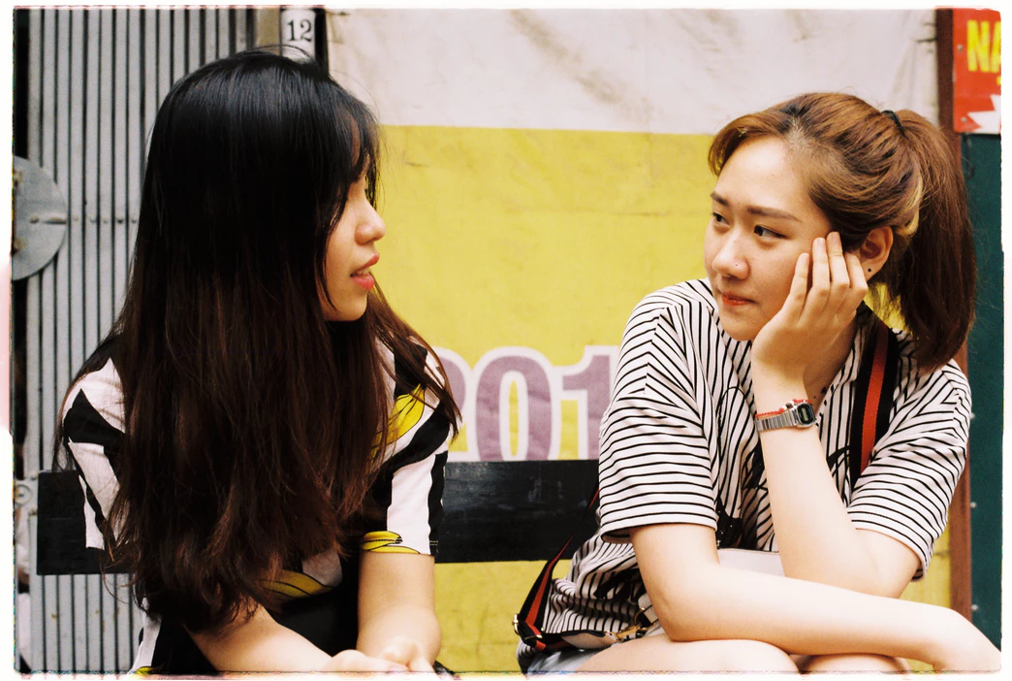
Reflections questions
Did you stay in the same groups or move around?​
​
Are any of you exactly the same in every way?​
​
Can you belong to some groups with some people and other groups with others?​
​
Does having something in common with someone mean you don’t have any differences?​

Slide 11


What is a 'generalisation'?

Slide 12

A generalisation is when we say something which is not necessarily true in all cases, or for all people.

Slide 13
all the students in this class love maths​ only girls like the colour green​ young people play computer games all day and never go outside​ people always share the same faith or belief as their family​ parks are unsafe
Example Generalisations

Slide 14
How do we feel about these statements? ​
Are they always true, are they true for everyone?​
Do we ever say things like this about the groups we belong to?​
Can you think about some other generalisations relevant to this school?
Reflection on generalisations

Slide 15
How does it feel when someone makes a generalisation about us?​
What happens when we make generalisations about our own or other communities?
Reflection on generalisations - extension

Slide 16
What is a Stereotype? (Years 5/6)

Slide 17
What is a stereotype?​
An oversimplified description of something. A partly or wholly untrue belief commonly held about a type of person or group of people.​
​
​
What does the word ‘nuance’ mean?​
When a description doesn't over-simplify, when it shows how complex the subject matter is.
Definitions (Years 5/6)

Slide 18
Activity 2:
What do generalisations sound like?

Slide 19

Activity scripts
Listen to /read the scripts and think about:
Are they speaking about themselves or generalising?​
Can we be sure that this is true for everyone?​
Could this statement, which may be partly true, be more specific?​
How can I make this more accurate?
Can you work out what is a generalisation in the script?
How could it be changed into an I statement?

Slide 20
Script 1
My name’s Nicole. I was christened in a Christian church. All Christian people attend church every Sunday. The favourite festival in our calendar is Easter, but honestly we eat too much on Easter day! I quite like the service, it’s nice to listen to, but the problem is people don’t really understand what’s being said! But it's good for us to go and see my friends and relatives.

Slide 21
Script 1
Generalisation: "The favourite festival in the calendar is Easter"
Change to: "My favourite festival in the calendar is Easter"
Generalisation: "but the problem is people don’t really understand what’s being said"
Change to: "but the problem is I don't really understand what's being said"
Generalisation: "But it's good for us to go and see our friends and relatives."
Change to: "Bit its nice for me to go and see my friends and relatives
Breakdown

Slide 22
Script 2
I’ve started to think about what I’d like to do when I leave school. Lawyers are boring so I don’t want to study law, but I do quite enjoy attending the debating club at school. My friends tell me that I’m good at PE but my parents say sport is just a hobby. Nobody my age really knows what they want to be doing ten years from now, but I would like to find something to focus on!

Slide 23
Script 2
Generalisation: "Lawyers are boring" change to
Change to: "I think I might find Law a boring subject"
Generalisation: "my parents say sport is just a hobby"
Change to: "my parents think sport is just a hobby"
Generalistaion: "Nobody my age really knows what they want to be doing ten years from now"
Change to: "I don’t know what I want to be going ten years from now"
Breakdown

Slide 24
Discuss
What are some of the dangers of using generalisations?
Why are I statements helpful?

Slide 25
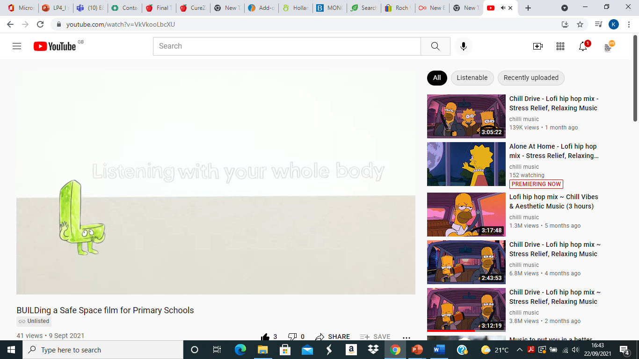
The next lesson is The Letter L. L is for listening with your whole body

