Slide 1
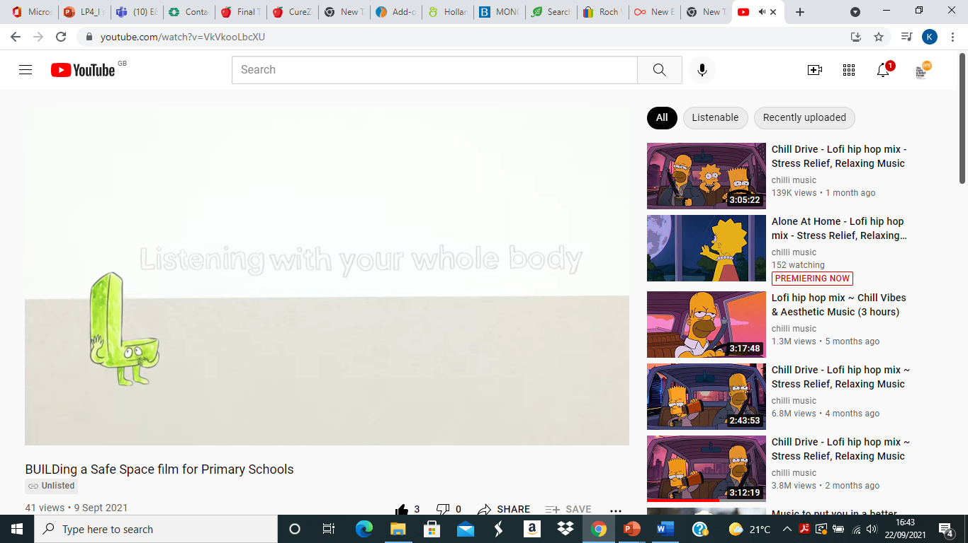

L is for Listening with your whole body

Slide 2
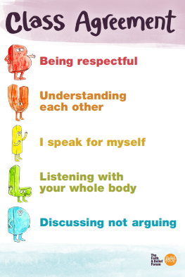
Our Class Agreement

Slide 3

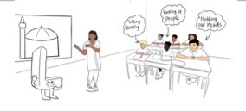
What is body language?
What do you think ‘listening with your whole body’ means?

Slide 4

It is important to show you are listening with your body language. Using eye contact, head nodding, facial expressions and hand gestures etc.

Slide 5
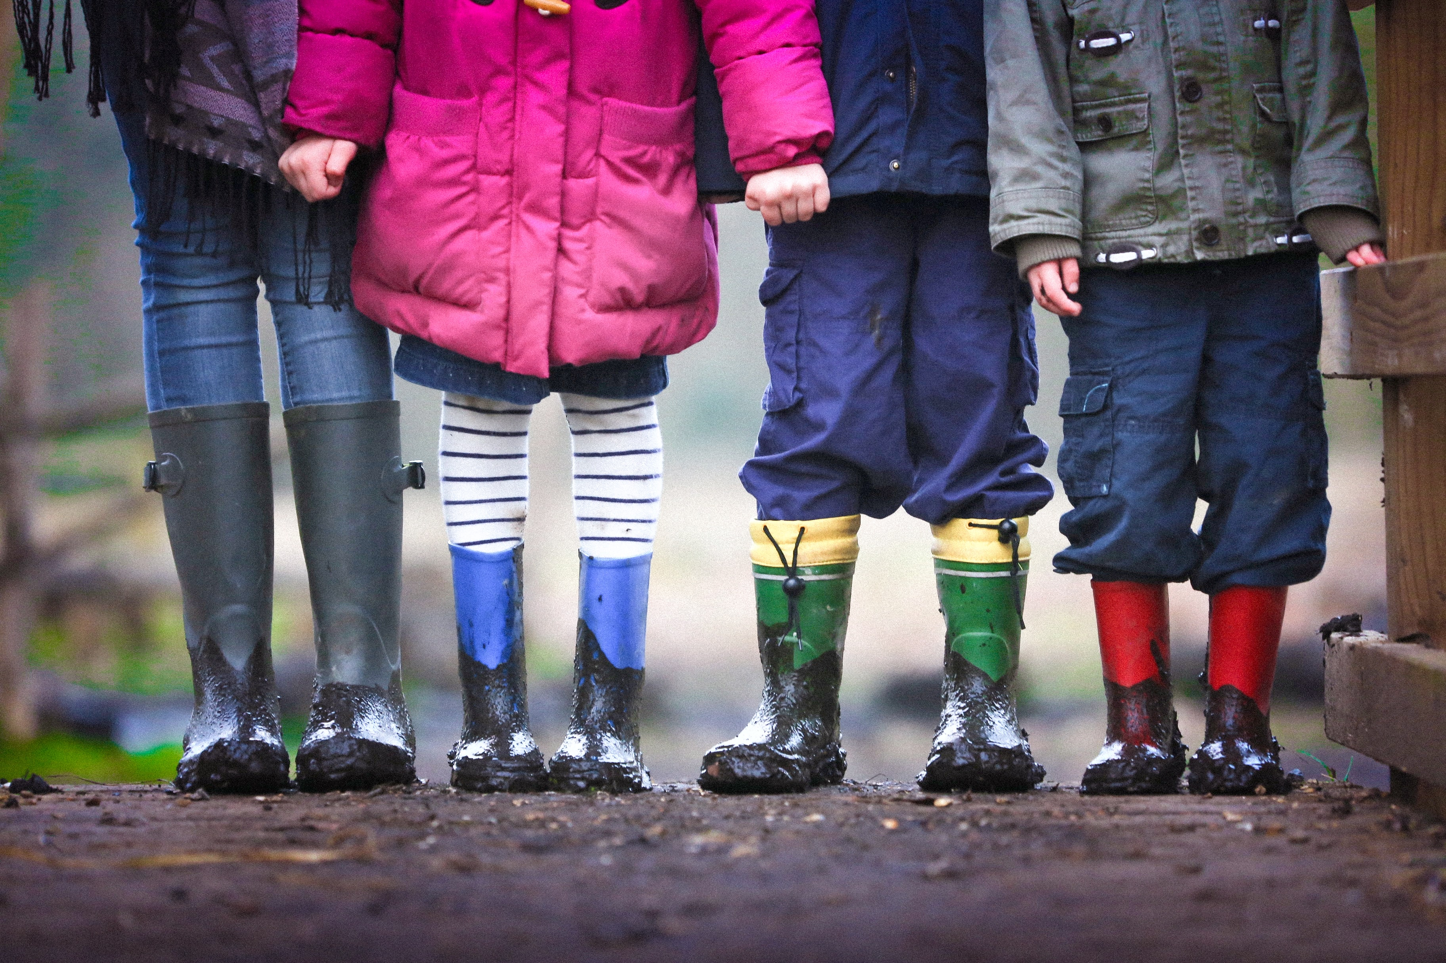
Activity 1: LINE UP!
In complete silence, form a line in…
1. height order​
​
After this then line up in order of:​
2. birthdays

Slide 6
Was it easy to do? Why / why not?
What body language did you use to communicate to each other?
What was the most important non-verbal communication skill needed to complete the activity?

Slide 7

Activity 2: Are you listening script?

Slide 8
Script 1
Script 1: What did you have for breakfast?
Person 1 Oh, I’m so hungry!
Person 2 Why? Its only 9:30! Did you not have breakfast?
Person 1 I did! It was just disappointing!
2 I’m sorry to hear it was disappointing… what did you have?
1 Well, I wanted to have Crunchy Yum Flakes, but my brother finished the box and didn’t tell anyone.
2 That sounds really frustrating! So what did you have?
1 A piece of toast. We also had no butter, so it was dry!
2 Without butter too, that’s rubbish! Don’t be jealous, but I had Crunchy Yum Flakes, though they’re not actually my favourite…

Slide 9
Script 1
Person 1: Really?! Then what is your favourite breakfast?
Person 2: I had my favourite breakfast on holiday this summer – blueberry pancakes with syrup and ice cream! They were warm and spongey and melted in my mouth. It felt like I was having dessert for breakfast!
Person 1 [PAUSE] Wow, I can see why pancakes are your favourite breakfast! Not so sure about ice cream in the morning, but it sounds like a fun experience!

Slide 10
Who ate all the Crunchy Yum Flakes?
What time was Person 1 hungry?
What adjectives were used to describe the pancakes?
What word did Person 1 use to describe their breakfast?

Slide 11
How can you show someone you are actively listening? Why is it important to really listen to someone? What might happen if we do not listen actively to others? Listening is a skill, and that it is so important we try to really listen to each other – not only in showing respect to others, but to have really meaningful conversations where we can learn and understand people better, especially those different to ourselves.

Slide 12
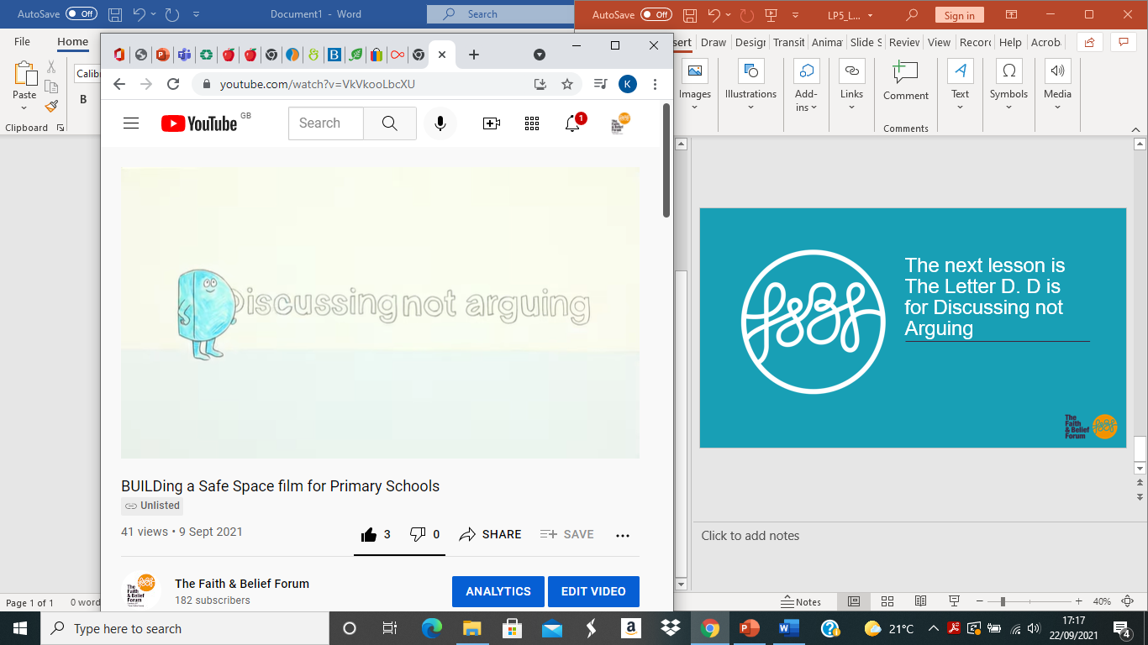
The next lesson is The Letter D. D is for Discussing not Arguing

