Slide 1
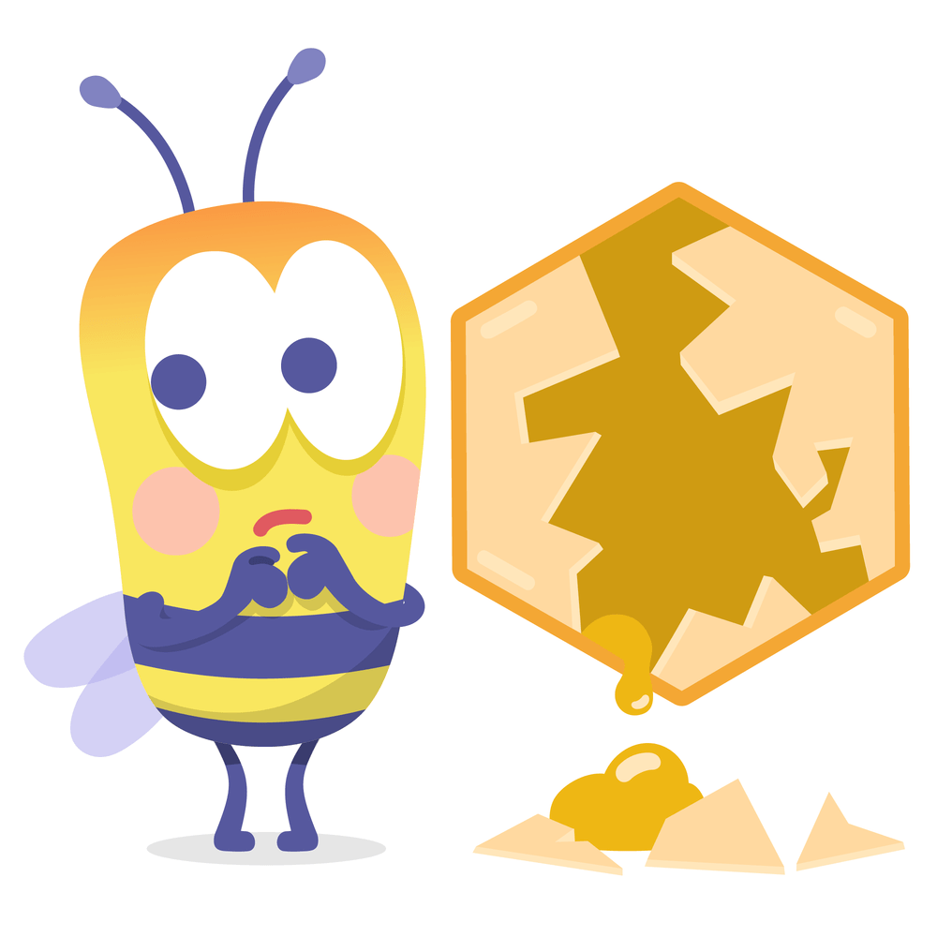


Oops and ouch

Slide 2
Today we are work out what to do when we get upset or upset someone when we are talking to each other.

Slide 3
Activity 1
oops and ouches of the week!
Forgot a birthday
Stubbed my toe
Forgot my homework
Cut my finger
Late for school

Slide 4
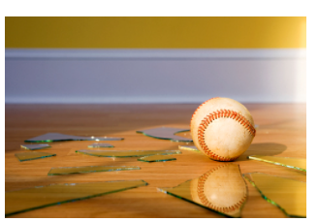
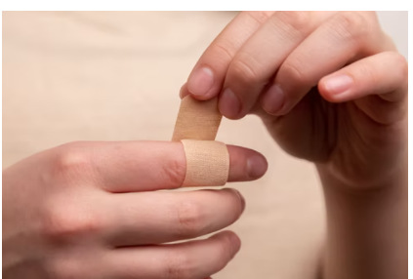
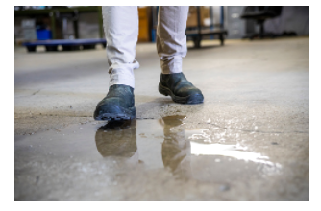

OOPS

Slide 5
Activity 2: Oops and ouch when talking to other people
Oops
When people are talking to each other, having a conversation, and someone says or thinks ‘oops’ what do you think might have happened?
Who has ever accidently said something upsetting or offensive and wished it hadn't come out that way?
Ouch
When talking to someone or in a conversation, and someone says 'Ouch' what do you think might have happened?
Who has ever felt upset or uncomfortable by something someone has said in a conversation? How did you feel?

Slide 6
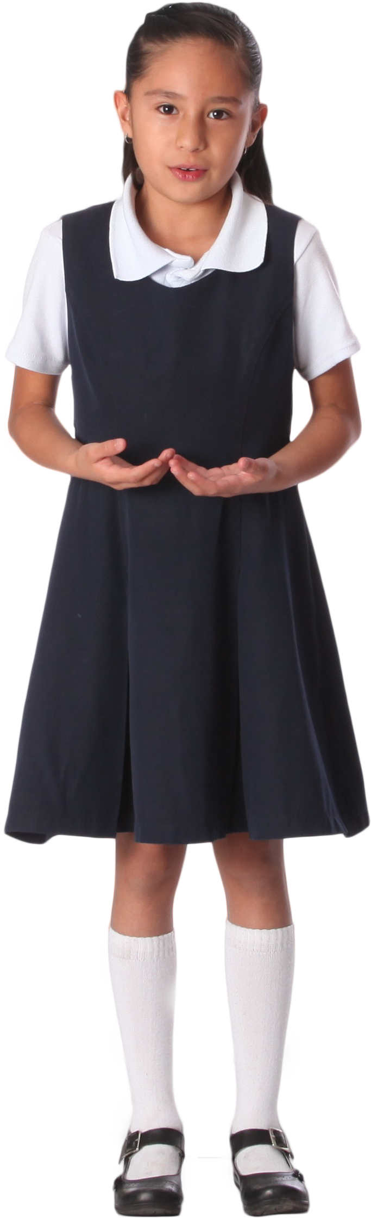
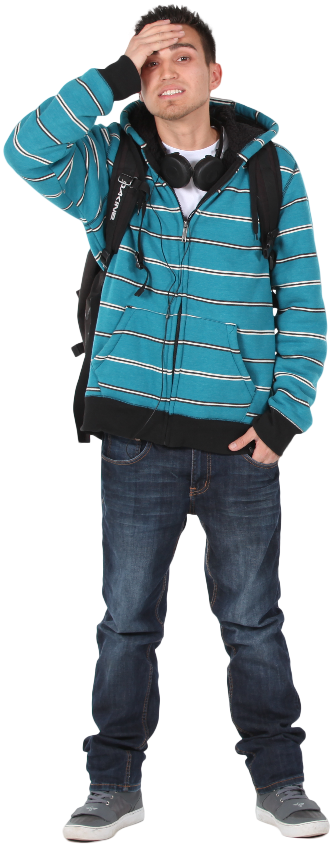
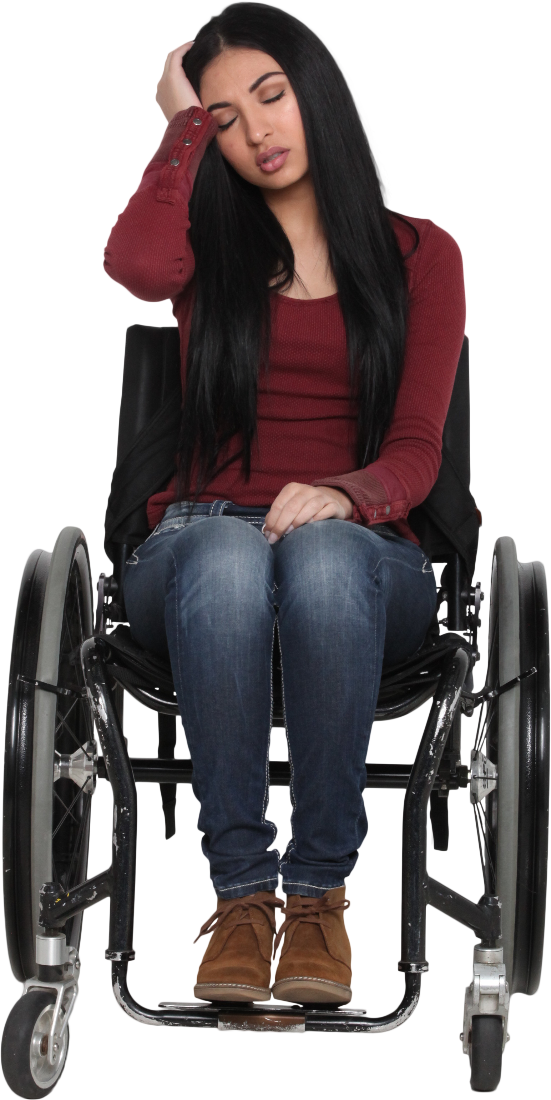
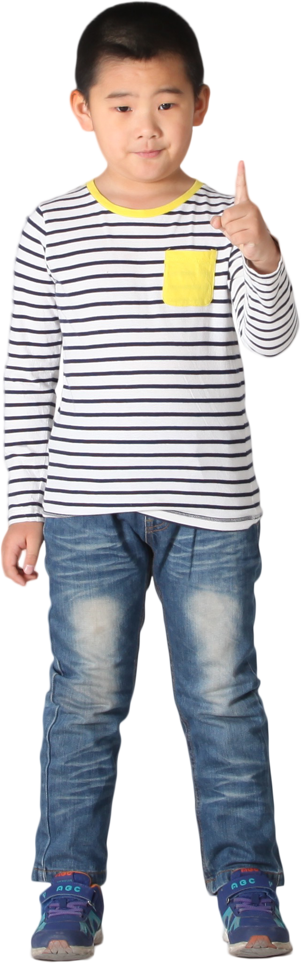
OOPS Body language

Slide 7
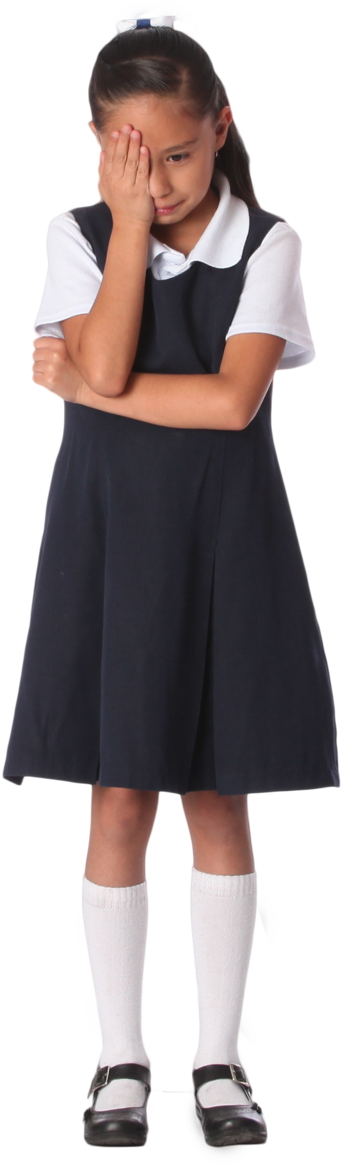
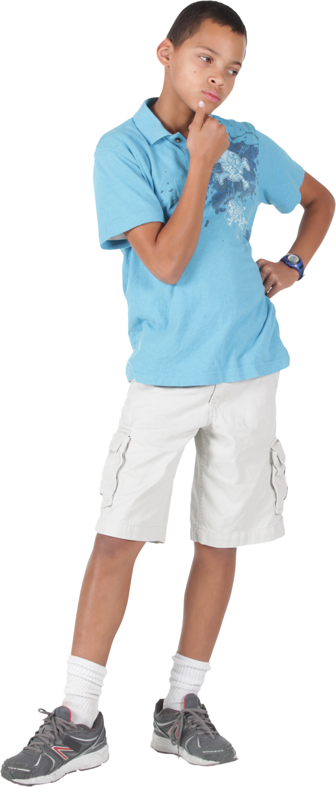

OUCH body language

Slide 8
ZIMO and JANNA

Slide 9
ZIMO and JANNA
ZIMO and JANNA
ZIMO: Hi Janna, are you excited about lunch today?
JANNA: Hi Zimo, what do you mean, what is happening at lunch today?
ZIMO: We are getting a roast meat dinner today!!
JANNA: I don’t eat meat, so it won’t be very special for me
ZIMO: Why not? That is so silly, meat is delicious.
JANNA: It’s not silly at all, think of the animals and the environment
ZIMO: Oh of course, I didn’t think
JANNA: Don’t worry, they always have a delicious vegetarian food on Wednesdays, so it will be special for me really

Slide 10
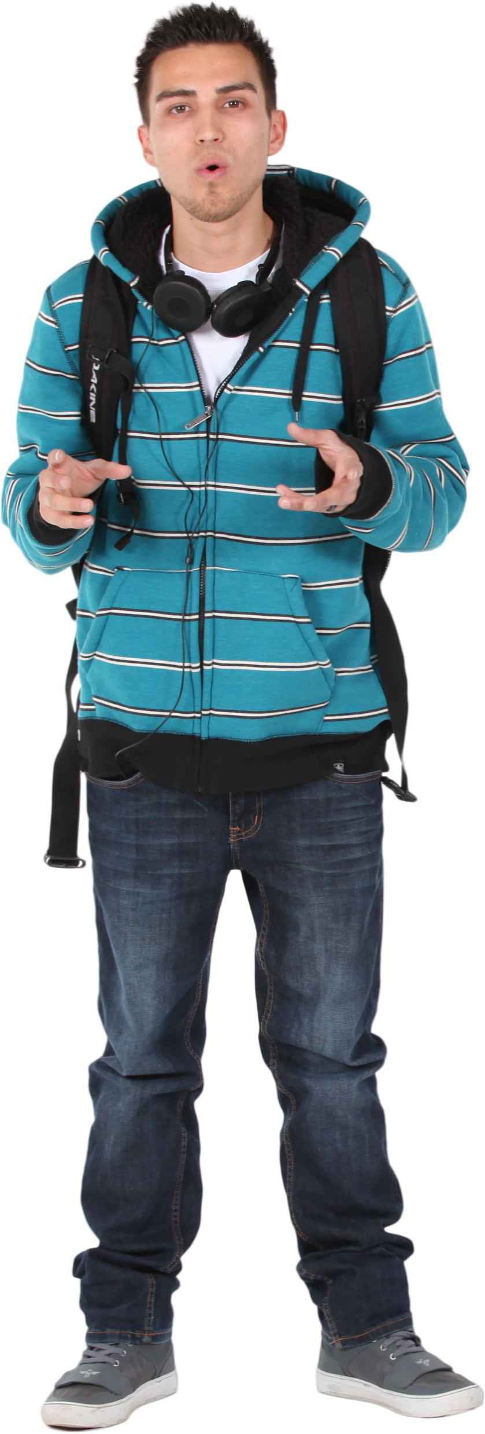
PRECIOUS AND JEFF

Slide 11

PRECIOUS AND JEFF
PRECIOUS: Hello Jeff, what time is it?
JEFF: Hi Precious, well err, it’s 9.20 in the morning
PRECIOUS: What time to you call this?
JESS: What do you mean?
PRECIOUS: I mean, you are late, you missed registration, again!
JEFF: Oh, well yeah, I know, but I am not in trouble
PRECIOUS: Well that’s not fair, when I am late I get into trouble, what is so special about you?
JEFF: Why are you being so nasty to me? I help look after my Mum remember, she has a disability, her carer was late today and I had to wait.
PRECIOUS: Oh Jeff, of course, I totally forgot about the situation with your Mum, sorry. It’s just I got really told off today for being late, and it really upset me, and I didn’t know why this happened to me and not you.
JEFF: Well OK, but I would be on time if I could, but I can imagine how it might be upsetting to see someone get away with being late if you didn’t know they had a valid reason.
PRECIOUS: What can I do to help? It must be hard being a carer as well as going to school every day.
JEFF: Thanks, yes, it would be great if you could remind any new teachers why I might be late in future.

Slide 12
PRECIOUS AND JEFF
Who is the ‘Ouch’ person and who is the ‘Oops person’?
Who acknowledges first that it was hurtful?
Does the ‘Ouch’ person manage to express how they feel, do you think it is difficult or easy to explain what is going on to the ‘Oops’ person?
Does the Oops person take responsibility and try to reframe what they said?
What’s the outcome of the situation?

Slide 13
Create your own oops and ouch role play
Oops moment
Ouch moment
Resolution

Slide 14

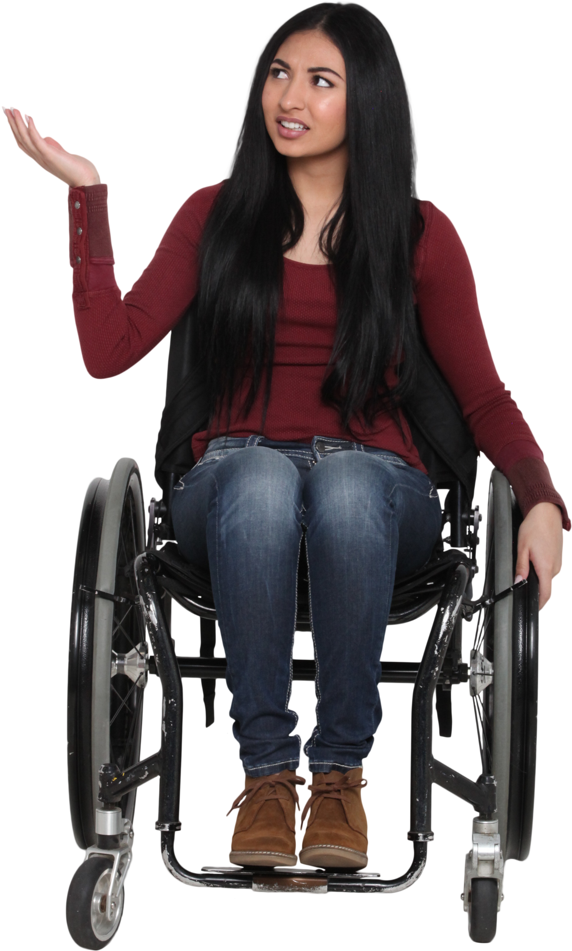
Create your own oops and ouch role play
Oops moment
Ouch moment
Resolution

Slide 15

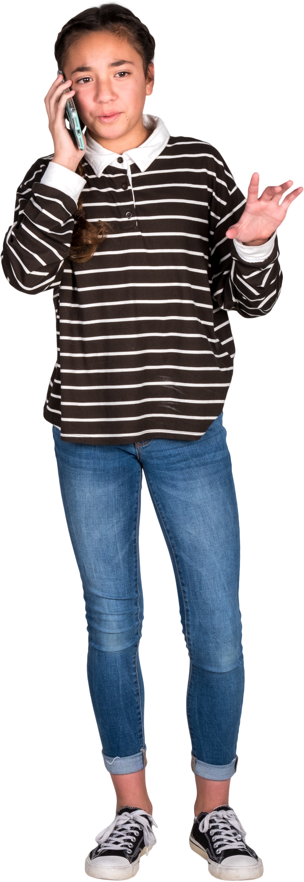
Create your own oops and ouch role play
Oops moment
Ouch moment
Resolution

Slide 16
Oops and Ouch top tips
Oops
Be aware of the impact of your words
Treat people how you want to be treated
Try to rectify the situation without having to be told to
Ouch
Remember that it’s ok to feel hurt sometimes
Feel free to express that you’d like someone to try again/reframe what they said
You can simply say ‘Ouch’ if you are struggling to find the words to express yourself

